Slide 1
CSCI-548: Information Integration on the Web Fall 2019
Jose Luis Ambite
Shobeir Fakhraei
University of Southern California
University of Southern California
Ambite, Knoblock and Szekely

Slide 2
Jose Luis Ambite, PhD
Associate Research Professor, Computer Science
Research Team Leader, Information Sciences Institute
Core expertise in data integration, coming from AI and DB background
Mediators, query rewirting
Schema mapping, source modeling
Entity Linkage
Semantic Web
Interests on biomedicine and genetics

Slide 3
Prof. Ambite: Recent Projects (1)
NIH-NIBIB Pediatric Research using Integrated Sensor Monitoring Systems (PRISMS): Data and Software Coordination and Integration Center (DSCIC) (prisms-study.org)
Predict asthma attacks based on multiple sources: smart watch, environmental sensors, geospatial data, EMAs, …
NIH Big Data to Knowledge (BD2K) Biomedical Data Science Training Coordination Center (bigdatau.org)
Automatically discover, describe, organize, and personalize training materials in biomedical big data.
NIH-NIMH SchizConnect (schizconnect.org)
Integrate distributed neuroimaging datasets

Slide 4
Prof. Ambite: Recent Projects (2)
DARPA Big Mechanism L2K2R2: Learn to Read to Know, Know to Learn to Read
Read cancer literature to automatically extract relevant pathway knowledge and causal models.
NIH-NHGRI Population Architecture using Genomics and Epidemiology (PAGE) Coordinating Center
Large (N~50K) genome-wide association study in multiple populations.
NIH-NIMH Center for Collaborative Genomic Studies of Mental Disorders
NIMH biorepository (with demographic, phenotypic, genetics, and biosample data)

Slide 5
Shobeir Fakhraei, PhD
Computer Scientist, Information Sciences Institute
Previously worked at Microsoft Research and Yahoo! Labs
Expertise in Machine Learning including Probabilistic Graphical Models, Graph Mining, Collective Inference, and Deep Learning
Entity Resolution
Link Prediction
Node Labeling
Network Extraction

Slide 6
Dr. Fakhraei: Recent Projects
Deep Learning for Entity Normalization
Network-based Pharmaceutical Discoveries
Social Spammer Detection
Recommender Systems

Slide 7
Course Overview

Slide 8
Information Integration Challenges
Accessing data
Information extraction from heterogenous sources: DBs, sensors, HTML, web services, text, tweets, …
Understanding, modeling data, and resolving differences
Schema-level: query rewriting, data exchange
Data-level: entity linkage, data cleaning, normalization
University of Southern California
Ambite, Knoblock and Szekely

Slide 9
…on the Web
The Web is an incredible source of data
New challenges arise:
Need to turn web pages into structured data
Don’t have control over the data
Sources have input/output constraints
Distributed nature of web can make integration slow
How to relate information across sources
Adding semantics to web data
University of Southern California
Ambite, Knoblock and Szekely

Slide 10

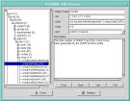
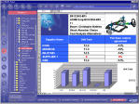
Application Area 1: Business
Enterprise Databases
EII Apps:
CRM
ERP
Portals
…
Single Mediated View
Legacy Databases
Services and Applications
50% of all IT $$$ spent here!
[from Doan, Halevy, Ives, Principles of Data Integration]

Slide 11
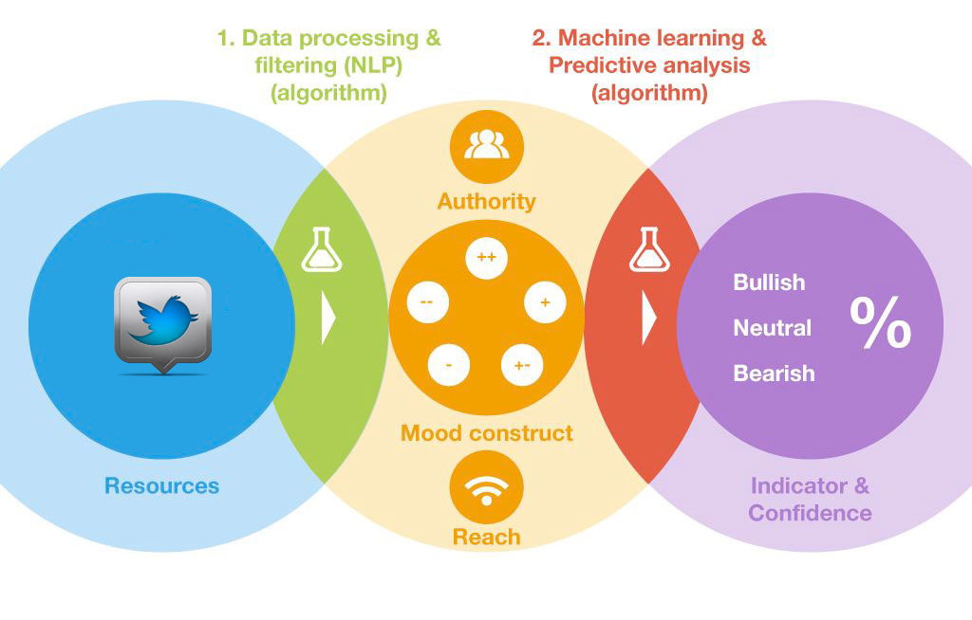
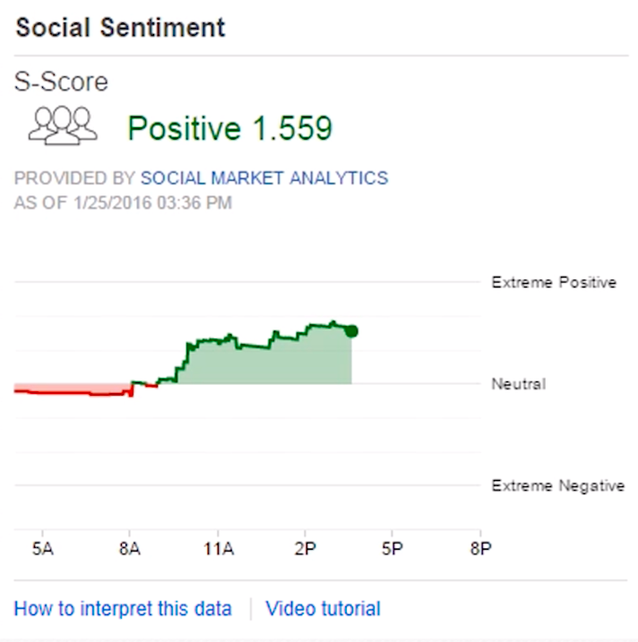

Application Area 1: Business Stock Market Sentiment Analysis

Slide 12
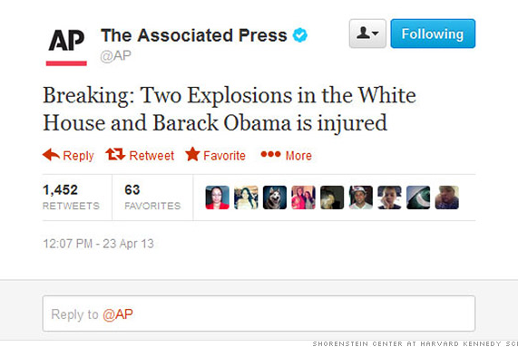
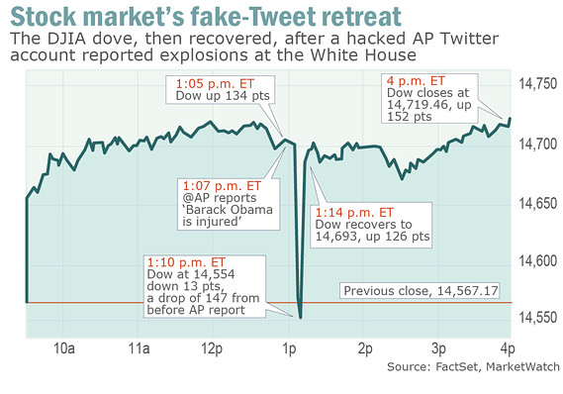
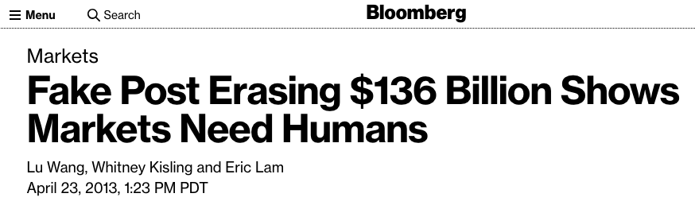
Application Area 1: Business Stock Market Sentiment Analysis

Slide 13
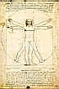


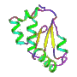
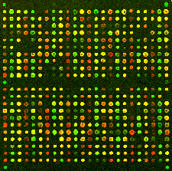

Application Area 2: Science
Phenotype
Gene
Sequenceable Entity
Structured Vocabulary
Experiment
Nucleotide Sequence
Microarray Experiment
Protein
OMIM
HUGO
Swiss-
Prot
GO
Gene-
Clinics
Locus-
Link
Entrez
GEO
Hundreds of biomedical data sources available; growing rapidly!
Check the Nucleic Acids Journal, Database Issue
[from Doan, Halevy, Ives, Principles of Data Integration]
Notes:
Shown query is courtesy of Hao Mei.
For all phenotypes in one database, find all gene, locus, product triples (GeneTests’ curator query).
For a given genetic disease, find all other diseases caused by the same gene (Joyce Mitchell, National Library of Medicine).
For a set of genes and proteins, find all matches (Marianne Barrier).
For some gene, find all homologues in other species (me).
Notes: Phenotype can be normal (as depicted) or abnormal (gross). Gene is misrepresented as a more concrete chromosome. Vocabulary picture stolen from Unified Medical Language System.

Slide 14


















Application Area 3: Web & Deep Web
[from Doan, Halevy, Ives, Principles of Data Integration]
Notes:
For example, comparison shopping: finding the cheapest books across all web bookstores.

Slide 15
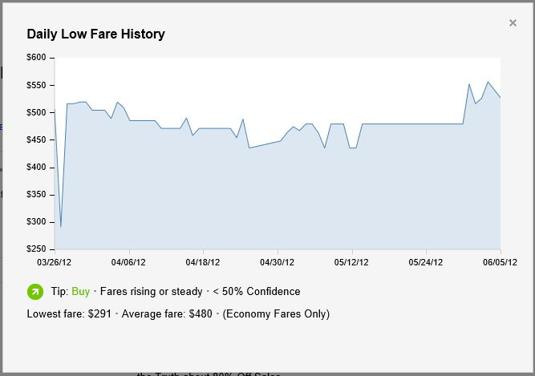
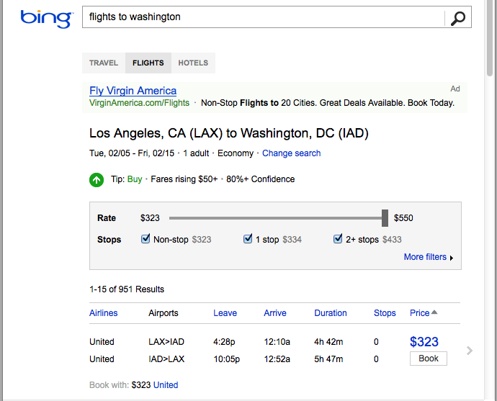
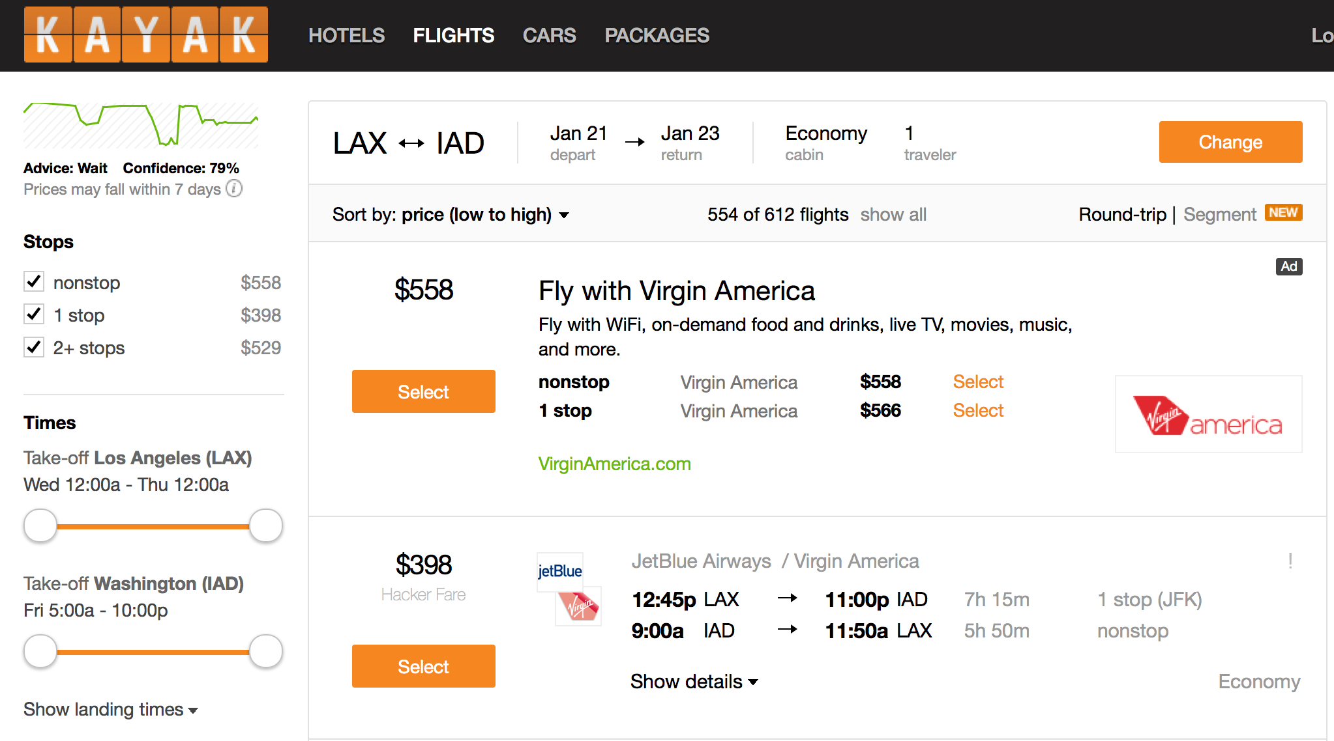
Web Example: Airfare Prediction
Monitor, integrate flight prices across airlines
Predict cheapest time to buy flight
[Etzioni, Knoblock, et al. KDD 2003], lead to startup: Farecast, bought by Microsoft, incorported in travel.bing.com, now in Kayak
University of Southern California
Ambite, Knoblock and Szekely

Slide 16
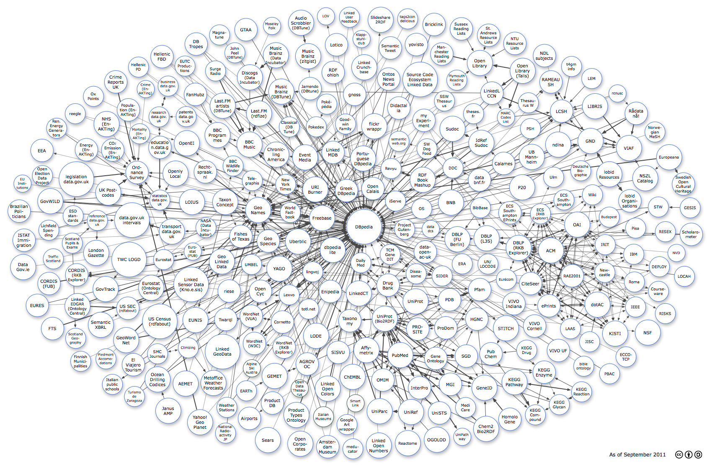
Application Area 4: Semantic Web & Linked Data
Notes:
Web ~~> distributed database of objects, add semantics for machine consumption, not just human

Slide 17
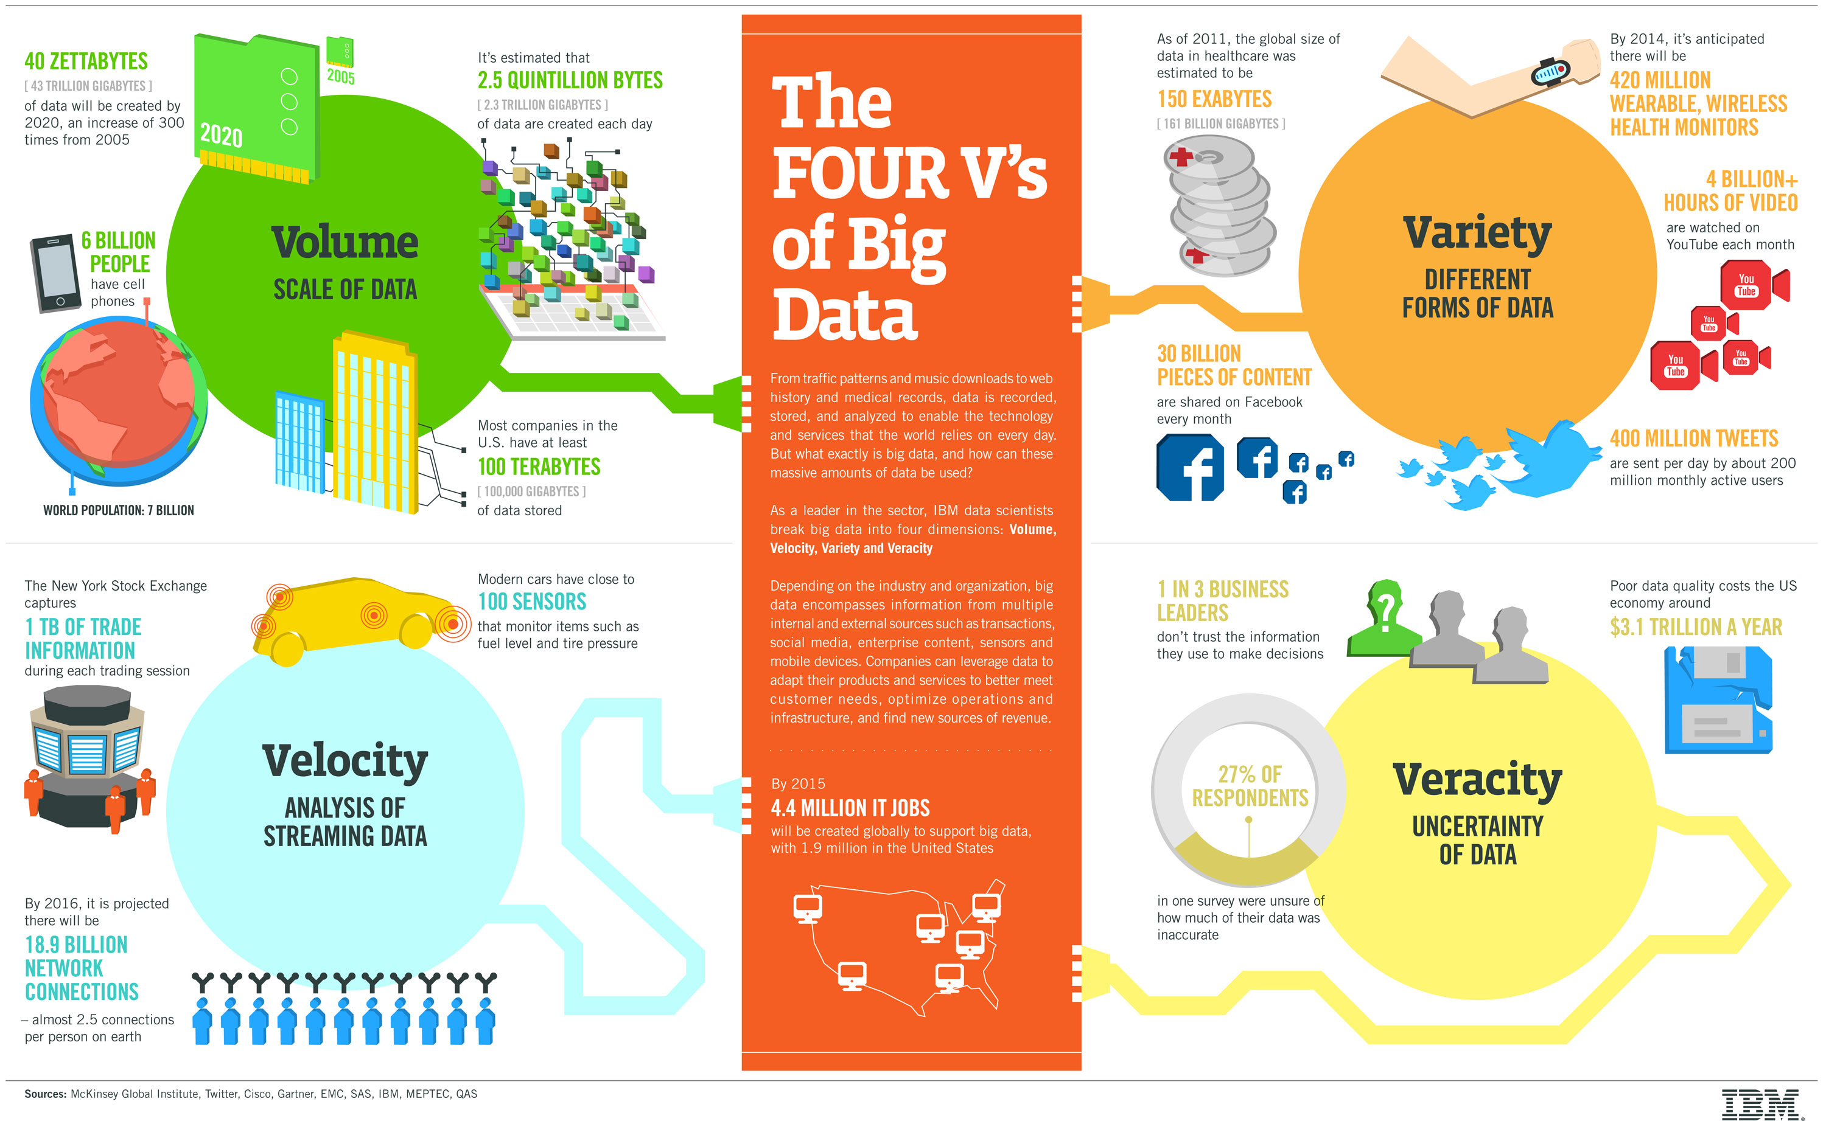
Application Area 5: Big Data
Notes:
Dimension of Big Data:
Volume: size of data in bytes, files, or data objects.
Velocity: rate or frequency at which new data can be acquired or processed.
Variety: diversity in data sources, data models, data types: geospatial, genetic, imaging, relational, XML, web services, RDF, …
Variability: diversity in data interpretation or meaning.
This course address Variety and Variability
Without semantics, big data = big mess

Slide 18
Typical Architecture
University of Southern California
Ambite, Knoblock and Szekely

Slide 19
Overview of Lecture Topics

Slide 20
Major Areas
Information Extraction
Semi-structured: Web, HTML
Unstructured: Text, Adds, Tweets, …
Entity Linkage, Data Cleaning, Normalization
Logical Data Integration
Mediators, Query Rewriting
Warehouse, Logical Data Exchange
Automatic Source Modeling/Learning Schema Mappings
Semantic Web
RDF, SPARQL, OWL, Linked Data
Advanced Topics
Geospatial Data Integration, Knowledge Graphs

Slide 21
Information Extraction
 | Topics | Readings | Homeworks | Instructor
Jan 7 | Course Introduction |  |  | Prof. Ambite
Jan 9 | Wrapper Generation | AnHai Doan, Alon Y. Halevy, and Zachary G. Ives. Principles of Data Integration, chapter 9. Morgan Kaufmann, 2012. Optional: Ion Muslea, Steve Minton, and Craig A. Knoblock. A hierarchical approach to wrapper induction … | HW1: Wrappers (due Jan 18) | Prof. Ambite
Jan 14 | Information Extraction 1: (Introduction, CRF, and Name Entity Extraction) | Andrew McCallum. Information Extraction: Distilling Structured Data from Unstructured Text. ACM Queue, volume 3, Number 9, 2005 Hanna M. Wallach, Conditional Random Fields: An Introduction, 2004. … |  | Dr. Fakhraei
Jan 16 | Information Extraction 2 (Name Entity Extraction, Relation Extraction) | Sarawagi, Sunita. "Information extraction." Foundations and Trends in Databases 1.3 (2008): 261-377 (Part 4). Michele Banko, Michael J Cafarella, Stephen Soderland, Matt Broadhead and Oren Etzioni, Open Information Extraction from the Web, 2007. | HW2: Information Extraction (due Jan 30) | Dr. Fakhraei
Jan 23 | Information Extraction 3 (Ungrammatical, Unstructered) | Matthew Michelson and Craig A. Knoblock. Semantic Annotation of Unstructured and Ungrammatical Text. IJCAI, Edinburgh, 2005 Ritter, Alan, Sam Clark, and Oren Etzioni. "Named entity recognition in tweets: an experimental study." Proceedings of the conference on empirical methods in natural language processing. Association for Computational Linguistics, 2011. Ritter, Alan, Oren Etzioni, and Sam Clark. "Open domain event extraction from twitter." SIGKDD. ACM, 2012. |  | Dr. Fakhraei Prof. Ambite
Jan 28 | Information Extraction 4 (Deep Learning Methods) | Ma, Xuezhe, and Eduard Hovy. "End-to-end sequence labeling via bi-directional LSTM-CNN-CRF." arXiv preprint arXiv:1603.01354 (2016). Optional: Li, Jing, et al. "A Survey on Deep Learning for Named Entity Recognition." arXiv preprint arXiv:1812.09449 (2018). |  | Dr. Fakhraei

Slide 22
Wrapper Generation and Learning
Turning online sources into structured information
Research Topics
Wrapper Learning
Automatic Wrapper Generation
Wrapper Maintenance
University of Southern California
Ambite, Knoblock and Szekely

Slide 23
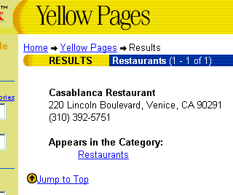
Wrapper Generation and Learning
NAME Casablanca Restaurant
STREET 220 Lincoln Boulevard
CITY Venice
PHONE (310) 392-5751
University of Southern California
Ambite, Knoblock and Szekely
Notes:
As the quantity and diversity of the information available online increases, more of the common information access tasks are done by program such as web wrappers. Wrappers faciliate access to Web-based information sources by providing a uniform querying and data extraction capability. For example, a Web wrapper for the yellow pages source can take a query for a Mexican restaurant near Marina del Rey, CA, and extract the restaurant’s name, its address and the phone number, in the same way as the information is extracted from a database.

Slide 24
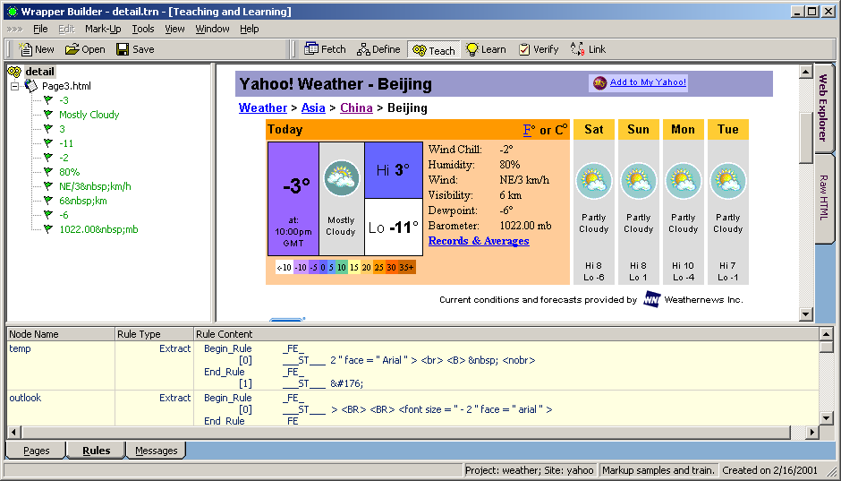
Wrapper generation and learning
Wrapper automatically learned based on a few examples
→ Startup: Fetch Technologies (www.fetch.com)
[Muslea, Minton & Knoblock, 1999]
[Knoblock, Lerman, Minton & Muslea, 2000]
Notes:
A few means around 3 examples, depending on the complexity of the site.

Slide 25
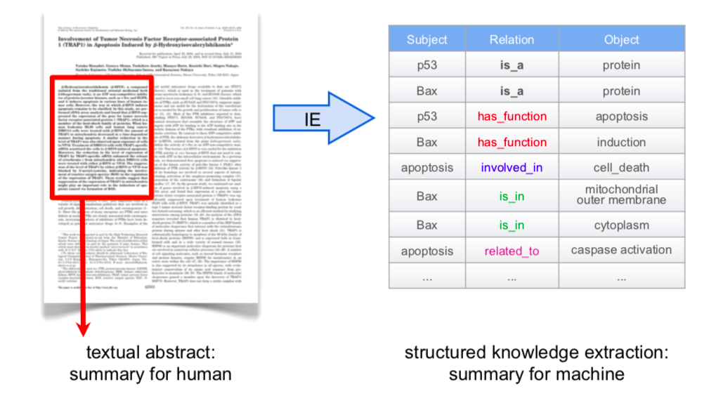
Information Extraction (IE)

Slide 26
Many applications of IE
Building & extending knowledge bases and ontologies
Scholarly literature databases: Google Scholar, CiteSeerX
People directories: Rapleaf, Spoke, Naymz
Shopping engines & product search
Bioinformatics: clinical outcomes, gene interactions, …
Patent analysis
Stock analysis: deals, acquisitions, earnings, hirings & firings
SEC filings
Intelligence analysis for business & government

Slide 27
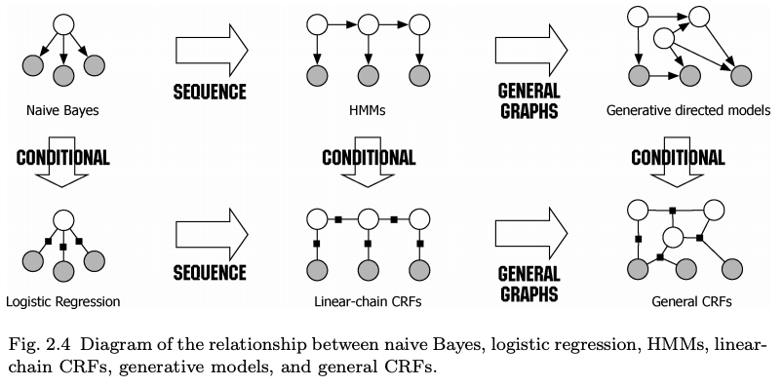
NER with Conditional Random Fields

Slide 28
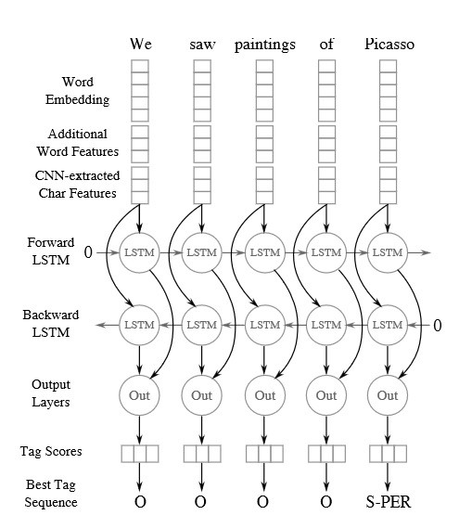
NER with Deep Learning

Slide 29
Relationship Extraction

Slide 30
Information Extraction: Unstructured, Ungrammatical
“1988 Honda Accrd for sale! Only 80k miles, Runs Like New, V6, 2WD... $2,500 obo. SUPER DEAL.”
University of Southern California
Ambite, Knoblock and Szekely

Slide 31
Information Extraction
Finding structure in text
Research Topics
Extraction using NLP techniques
Extraction with Conditional Random Fields
Exploiting reference sets for extraction
Deep Learning Techniques
University of Southern California
Ambite, Knoblock and Szekely

Slide 32
Entity Linkage, Data Cleaning, Normalization
 | Topics | Readings | Homeworks | Instructor
Jan 30 | Entity Linkage 1: (String Matching) | AnHai Doan, Alon Y. Halevy, and Zachary G. Ives. Principles of Data Integration, Chapter 4 (String Matching). Morgan Kaufmann, 2012. |  | Dr. Fakhraei
Feb 4 | Entity Linkage 2: (Overview) | AnHai Doan, Alon Y. Halevy, and Zachary G. Ives. Principles of Data Integration, Chapter 7 (Data Matching). Morgan Kaufmann, 2012. | HW3:Entity Linkage (due Feb 15) | Dr. Fakhraei
Feb 6 | Entity Linkage 3: (Advanced Topics) | Jure Leskovec, Anand Rajaraman, Jeff Ullman. Mining of Massive Datasets, Chapter 3 (Finding Similar Items). Singla, Parag, and Pedro Domingos. "Entity resolution with markov logic." Data Mining, 2006. ICDM 2006. |  | Dr. Fakhraei
Feb 11 | Entity Linkage 4: (Deep Learning Methods) | Fakhraei, Shobeir, and Jose Luis Ambite. "NSEEN: Neural Semantic Embedding for Entity Normalization." arXiv:1811.07514 (2018). Ebraheem, Muhammad, et al. "Distributed representations of tuples for entity resolution." VLDB 2018 Optional: Mudgal, Sidharth, et al. "Deep Learning for Entity Matching: A Design Space Exploration." SIGMOD 2018. |  | Dr. Fakhraei
Feb 13 | Data Cleaning (openrefine, Wrangler, trifecta, tamr) Normalization | Erhard Rahm, Hong Hai Do. Data cleaning: problems and current approaches. IEEE Data Engineering Bulletin, 2000. https://dbs.uni-leipzig.de/file/TBDE2000.pdf Wrangler: Interactive visual specification of data transformation scripts. In Proceedings of the SIGCHI Conference on Human Factors in Computing Systems, 2011. http://vis.stanford.edu/papers/wrangler. Open Refine, Explore data. http://youtu.be/B70J_H_zAWM. Open Refine, Clean and transform data. http://youtu.be/cO8NVCs_Ba0. Open Refine, Reconcile and match data. http://youtu.be/5tsyz3ibYzk. | HW4: Data Cleaning (due Feb 22) | Prof. Ambite

Slide 33
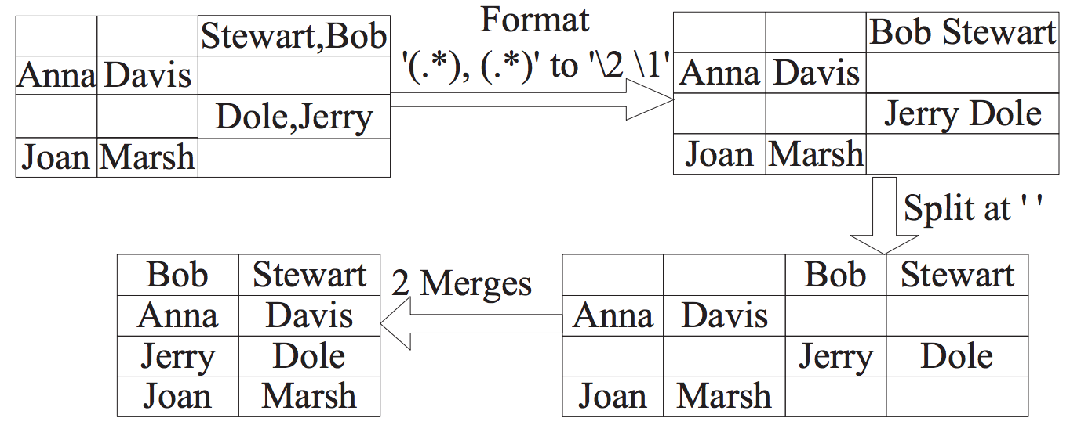
Data Cleaning/Transformation
[From Raman&Hellerstein, VLDB 2001]
University of Southern California
Ambite

Slide 34
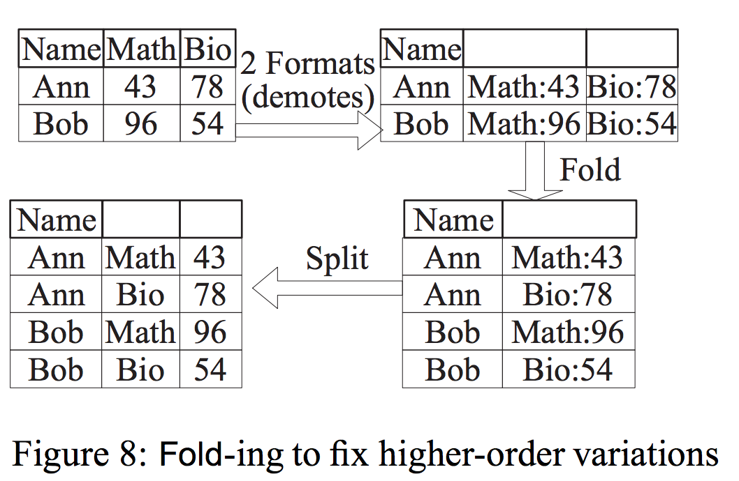
Data Cleaning/Transformation
[From Raman&Hellerstein, VLDB 2001]
University of Southern California
Ambite

Slide 35
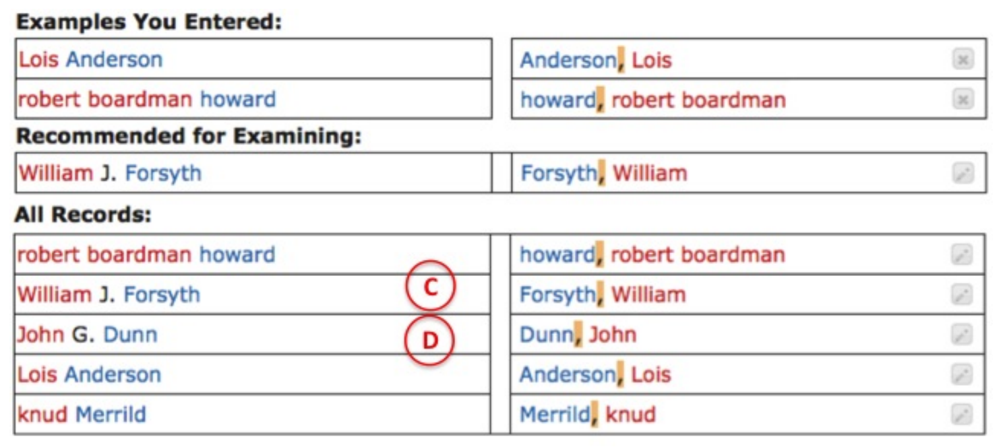
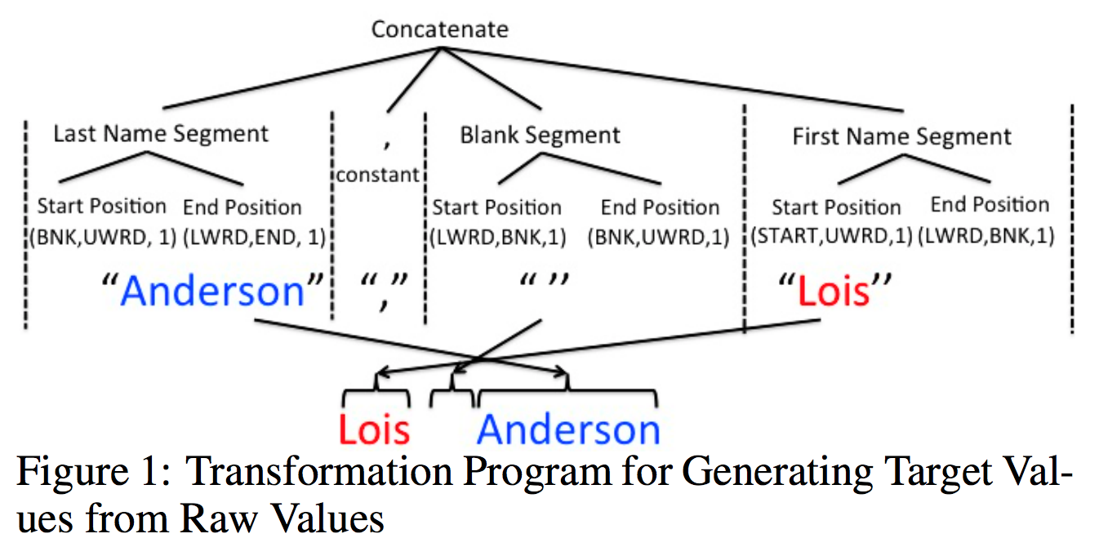
Data Transformation By Example
University of Southern California
Ambite, Knoblock and Szekely

Slide 36
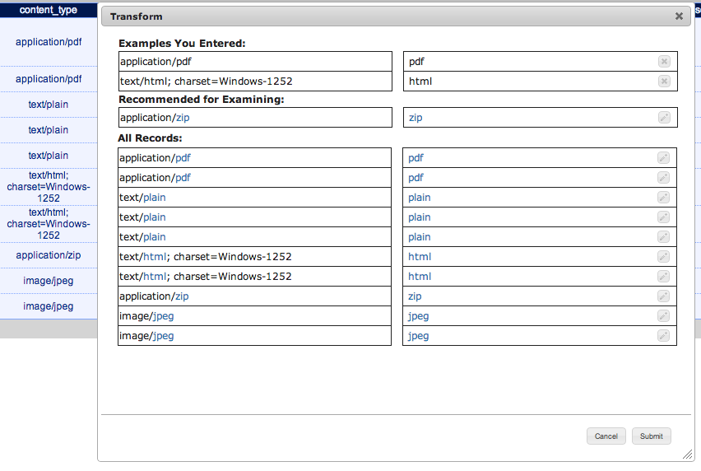
Data Transformation By Example
University of Southern California
Ambite, Knoblock and Szekely

Slide 37
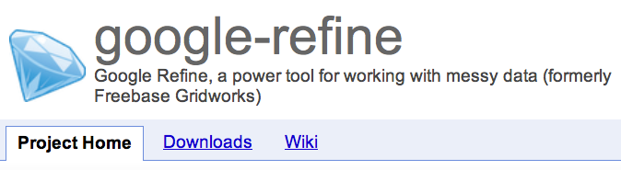



Data Cleaning/Transformation
Types of dirty data
Challenges
Detection
Fixing
Large data sets
Techniques
Research problems
University of Southern California
Ambite, Knoblock and Szekely

Slide 38
String Similarity: Why Strings Don’t Match Perfectly?
typos
"Joh” vs “John”
OCR errors
"J0hn” vs “John”
formatting conventions
”03/17” vs “March 17”
abbreviations
”J. S. Sargent” vs “John Singer Sargent”
nick names
”John” vs “Jack”
word order
”Sargent, John S.” vs “John S. Sargent”
University of Southern California
Ambite, Fakhraei, Knoblock and Szekely

Slide 39
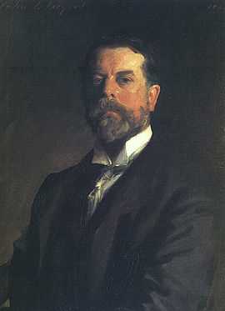
String Similarity Problem Definition
Given X and Y sets of strings
Find pairs (x, y)
such that both x and y
refer to the same real world entity
"John S. Sargent"
"John Singer Sargent"
University of Southern California
Ambite, Knoblock and Szekely

Slide 40
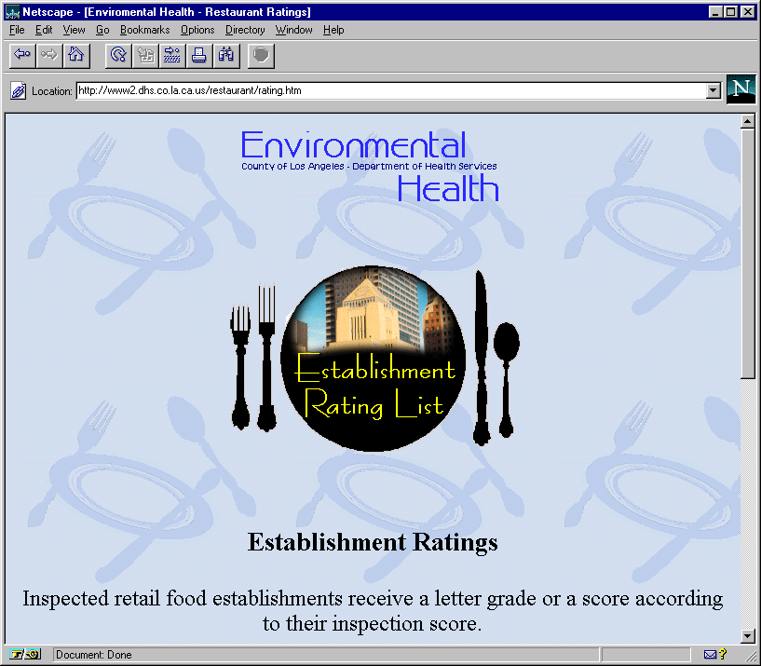
Record Linkage
Zagats Restaurant
Guide Source
Department of Health
Restaurant Source
Art’s Deli
California Pizza Kitchen
Campanile
Citrus
Grill, The
Philippe The Original
Spago
Art’s Delicatessen
Ca’ Brea
CPK
The Grill
Patina
Philippe’s The Original
The Tillerman
When objects in different sources correspond to the same entity?
University of Southern California
Ambite, Knoblock and Szekely

Slide 41
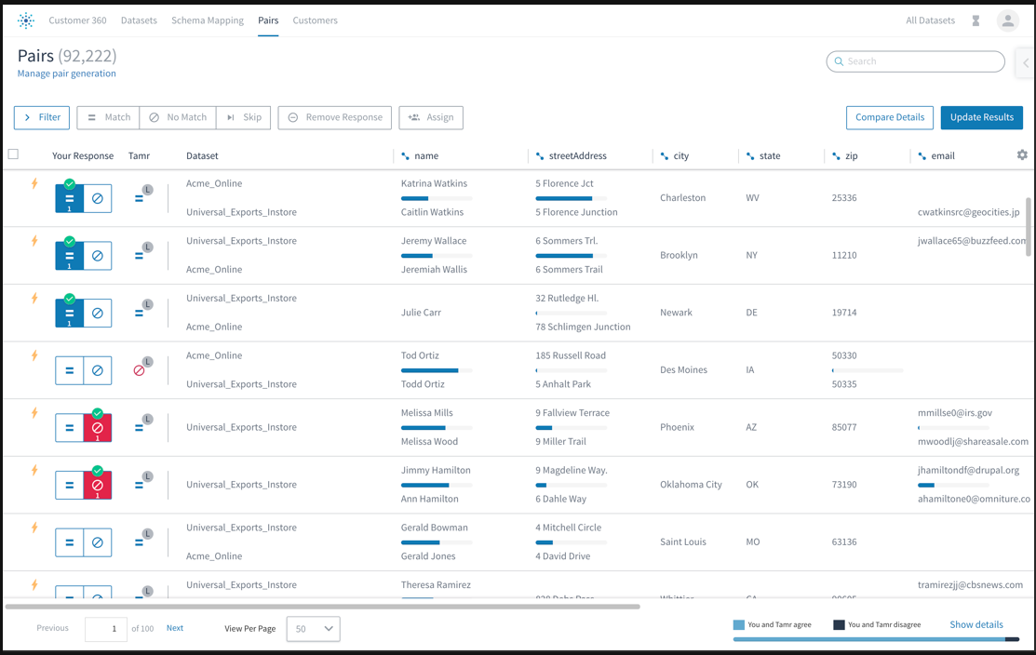
Tamr: Record Matching

Slide 42
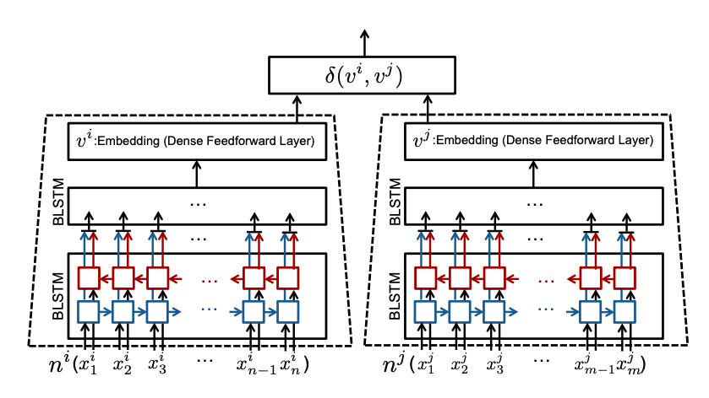
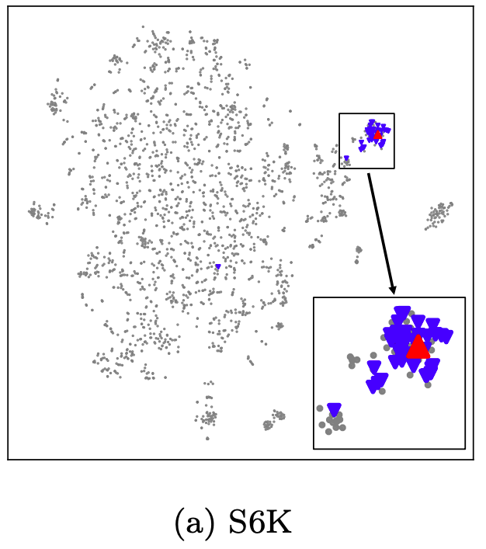
Record Linkage with Deep Learning

Slide 43
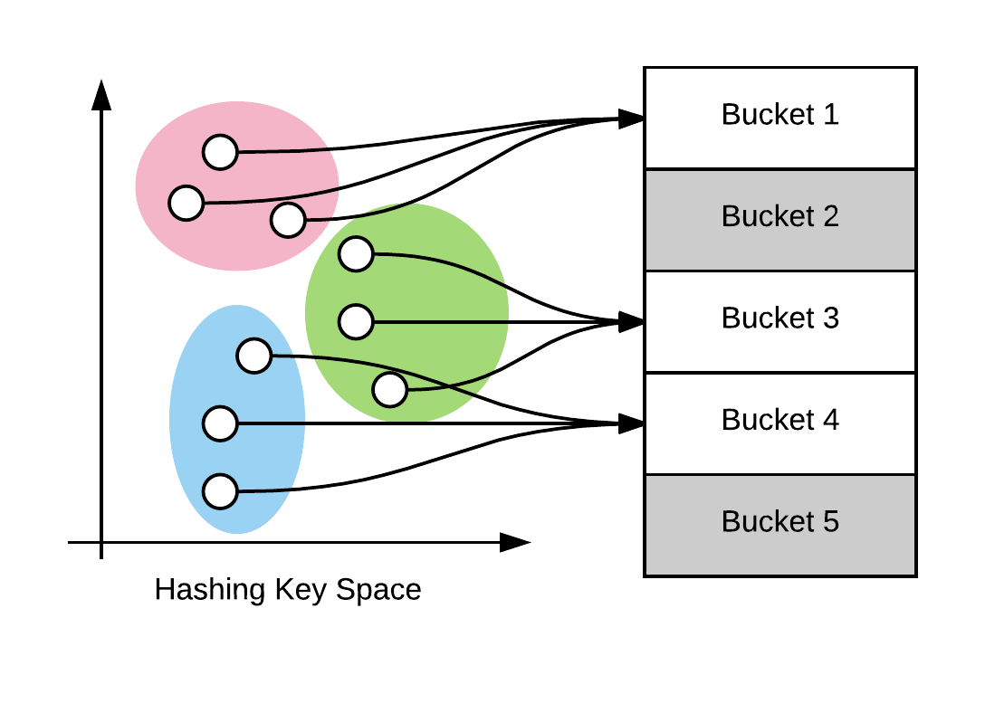
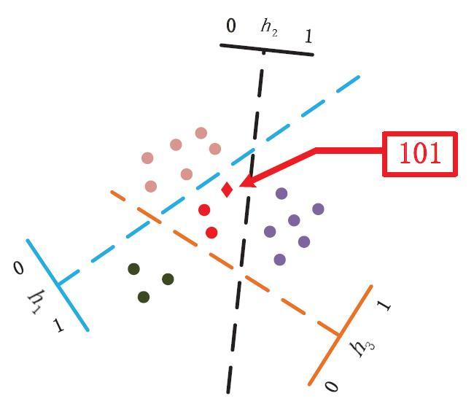
Blocking (Hashing)

Slide 44

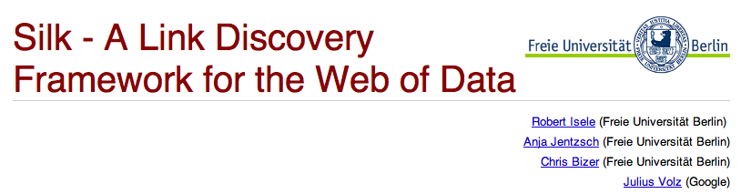
Record Linkage
Align entities across sources
Research Topics:
Blocking
Matching individual attributes
Matching records
Matching entities
University of Southern California
Ambite, Knoblock and Szekely

Slide 45
Logical Data Integration
 | Topics | Readings | Homeworks | Instructor
Feb 20 | Database Theory Basics | AnHai Doan, Alon Y. Halevy, and Zachary G. Ives. Principles of Data Integration, chapter 2.1, 2.2, 2.3 and 2.4. Morgan Kaufmann, 2012. |  | Prof. Ambite
Feb 25 | Logical Data Integration 1 (Query Rewriting) | AnHai Doan, Alon Y. Halevy, and Zachary G. Ives. Principles of Data Integration, chapter 2.4, 3.1, 3.2, 3.3, 3.4. Morgan Kaufmann, 2012. | HW5: Logical Data Integration (due March 8) | Prof. Ambite
Feb 27 | Logical Data Integration 2 (Scalability) | Alon Halevy and Rachel Pottinger. A scalable algorithm for answering queries using views. The VLDB Journal The International Journal on Very Large Data Bases, 2001. Scalable query rewriting: a graph-based approach, SIGMOD 2001. |  | Prof. Ambite
Mar 18 | Data Warehousing: Logical Approaches, Kafka/Spark | AnHai Doan, Alon Y. Halevy, and Zachary G. Ives. Principles of Data Integration, chapter 10. Morgan Kaufmann, 2012. Optional: Dimitris Stripelis, Jose Luis Ambite, Yao-Yi Chiang, Sandrah P. Eckel, and Rima Habre. A Scalable Data Integration and Analysis Architecture for Sensor Data of Pediatric Asthma. ICDE 2017. Dimitris Stripelis, Chrysovalantis Anastasiou, José Luis Ambite. Extending Apache Spark with a Mediation Layer. International Semantic Big Data Workshop, SIGMOD, 2018. |  | Prof. Ambite Dimitri Stripelis

Slide 46
Database theory basics: queries, query containment, Datalog
Conjunctive queries
q1(x) :- r(x,x) [≡ select R.a from R where R.a=R.b]
Query containment
q2(x) :- r(x,x), r(x,y1), r(y1, y2), r(y2, y3), r(y3,x)
q1 = q2 ???
Recursive logic programs: Datalog
path(X, Y) :- arc(X, Y)
path(X, Y) :- path(X, Z), path(Z, Y).

Slide 47
Logical Data Integration
Warehouses: Extract-transform-load (ETL)
Virtual Integration: mediators
Automatically select and compose information across sources
Research Topics
Modeling language: Relational, XML, Description Logics (OWL 2 & Profiles)
Schema mappings: Logical formulas that relate source and global schemas
Global-as-View (GAV), Local-as-View (LAV) integration, more general formulas (GLAV)
Scalability: efficient query rewriting, query optimization
Sample Tools
Research: BIRN mediator
Commercial: IBM InfoSphere Federation Server, Oracle Data Integrator, Talend, Informatica, Expressor, Infobright, …
University of Southern California
Ambite, Knoblock and Szekely

Slide 48
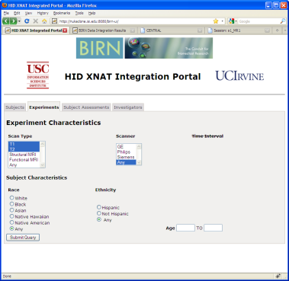
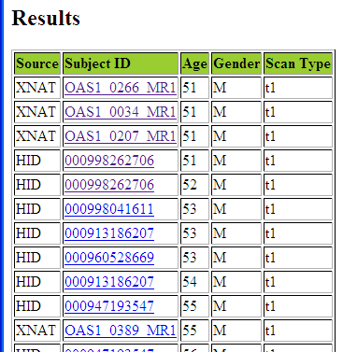
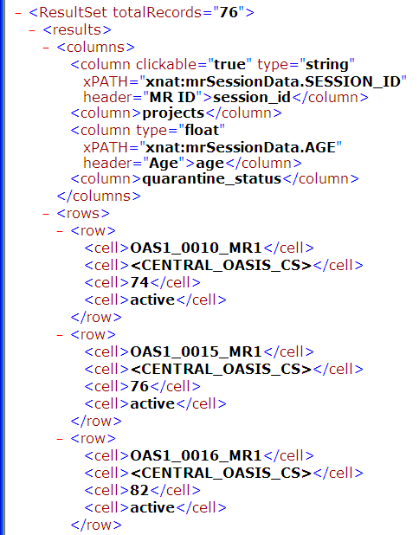
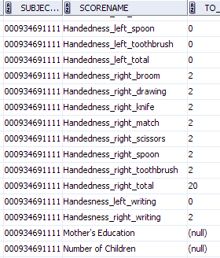
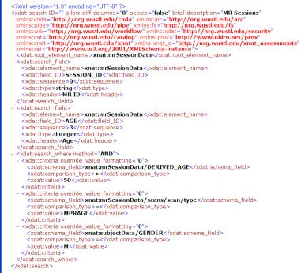
FBIRN Neuroimaging Integration
User query:
find all male patients over 50 with t1 scans
Results integrated
from XNAT and HID
Domain query
Integrated results
Logical Source
descriptions
BIRN Mediator
XNAT
results
(XML)
SQL
query
HID
results
XML
query
HID
@UCI
HID
@MRN
…
XNAT
Human Imaging Database(s)
Oracle DB
EXtensible Neuroimaging Archive Toolkit
Web service API
[Front. NeuroScience 2010]

Slide 49
Logical Data Integration: Schema Mappings
Mediators use logical schema mappings
Source-to-target tuple-generating dependencies (st-tgds), aka global/local as view (GLAV) mappings
∀X Y φ_{S}(X,Y) → ∃Z ψ_{G}(X,Z)
Intuitively: query over source predicates (antecedent Φ_{S}), whose answers populate the domain/target predicates (consequent Ψ_{G})
S1_EXPSEGMENT(eID, projectID, subjectID, prtclID, date …) ^ S2_PROTOCOL(prtclID, protocolDescription, …) → Scan(eID, subjectID, prtclID, date …) ^ hasDisease(subjectID, ‘Bipolar’)
Subject(subjectID, age, ‘Male’, …) ^ T1(prtclID) ^ age >= 40
Mappings used to answer queries or to generate ETL plans
Notes:
GLAV rule describes T1 scans performed male patients over 40 years old diagnosed with bipolar disorder
Data needs to be obtained from two source predicates (tables): HID__NC_EXPSEGMENT, HID__NC_PROTOCOL.
This rule can be intuitively understood as evaluating a query over the source predicates (antecedent), whose answers populate the domain/target predicates (consequent). For example, the acqID and subjectID arguments of S1_EXPSEGMENT will be transferred to the first argument of domain predicate Subject and the second argument of the Scan domain predicate.
Shared arguments denote joins, so that hasDisease indicates the disease for each subject in an experiment.
Consequent can specify additional knowledge. For exmaple that in those tables there are only Males with Bipolar disorder over 40.
Arguments that appear only in the consequent are existentially quantified varaibles (skolems). They represent objects that must exist but are not (yet) known.
For example, in this rule we do not know the age of the subjects, but we know is over 40 years old. This is powerful.

Slide 50
Query Rewriting
Given Query Q for T1 scans of Male subjects over 50 (over domain schema)
Q(subjectID, age, diseaseID, eID) ← Subject(subjectID, age, ‘Male’, …) ^ hasDisease(subjectID, diseaseID) ^ Scan(eID, subjectID, prtclID, date …) ^ T1(prtclID) ^ age > 50
and Schema Mappings m1 and m2:
m1: S1_EXPSEGMENT(eID, projectID, subjectID, prtclID, date …) ^ S2_PROTOCOL(prtclID, protocolDescription, …) → Scan(eID, subjectID, prtclID, date …) ^ hasDisease(subjectID, ‘Bipolar’)
Subject(subjectID, age, ‘Male’, …) ^ T1(prtclID) ^ age >= 40
m2: S3_SUBJECT(subjectID, age, gender, …) → Subject(subjectID, age, gender, …)
System rewrites query Q to an executable query Q’ (over source schemas)
Q’(subjectID, age, ‘Bipolar’, eID) ← S1_EXPSEGMENT(eID, projectID, subjectID, prtclID, date …) ^ S2_PROTOCOL(prtclID, protocolDescription, …) ^ S3_SUBJECT(subjectID, age, gender, …) ^ age > 50
Q’ is translated to evaluation plan or ETL workflow (next slide)
Notes:
Example of query rewriting
Note that in Q’ there is no need to add a constraint gender = ‘Male’. It is implied by m1 that produces only males.
If the constraint age>50 was not there, we wouldn’t need the call to the source S3_SUBJECT.
Q’ needs to include S3_SUBJECT(subjectID, age, gender, …) ^ age > 50 because m1 only implies that the subjects are over 40. So needs additional selection to filter out 40 to 50.
It query had been age > 30, then we would not need to include s3_SUBJECT, since s1_EXPSEGMENT alone already implies age >= 40 and therefore age >=30.
Technically, Q’ is contained in Q. It gives a subset of the answers of Q. However, if m1 and m2 are the only mappings, this is the best that can be done. This is called the maximally-contained rewriting.

Slide 51
Scalable Data Integration
Query rewriting is NP-hard, but
GQR [Konstantinidis & Ambite, SIGMOD 2011] can rewrite user query over 11,000 source mappings (i.e., 100 tables in 110 DBs) in under 1 second

Slide 52
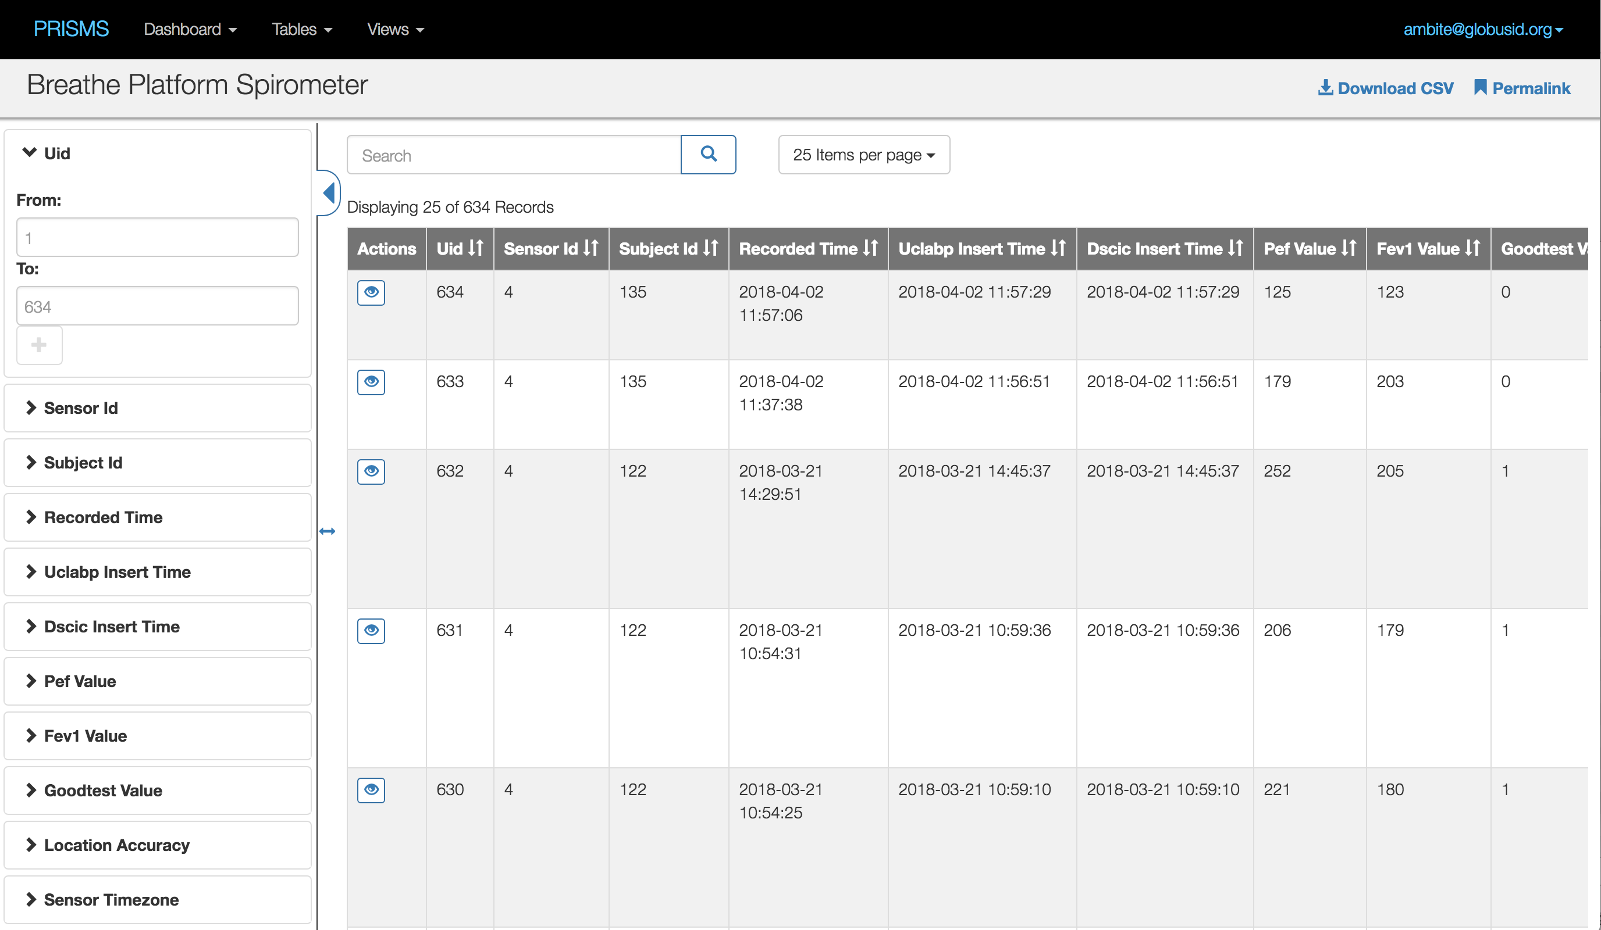
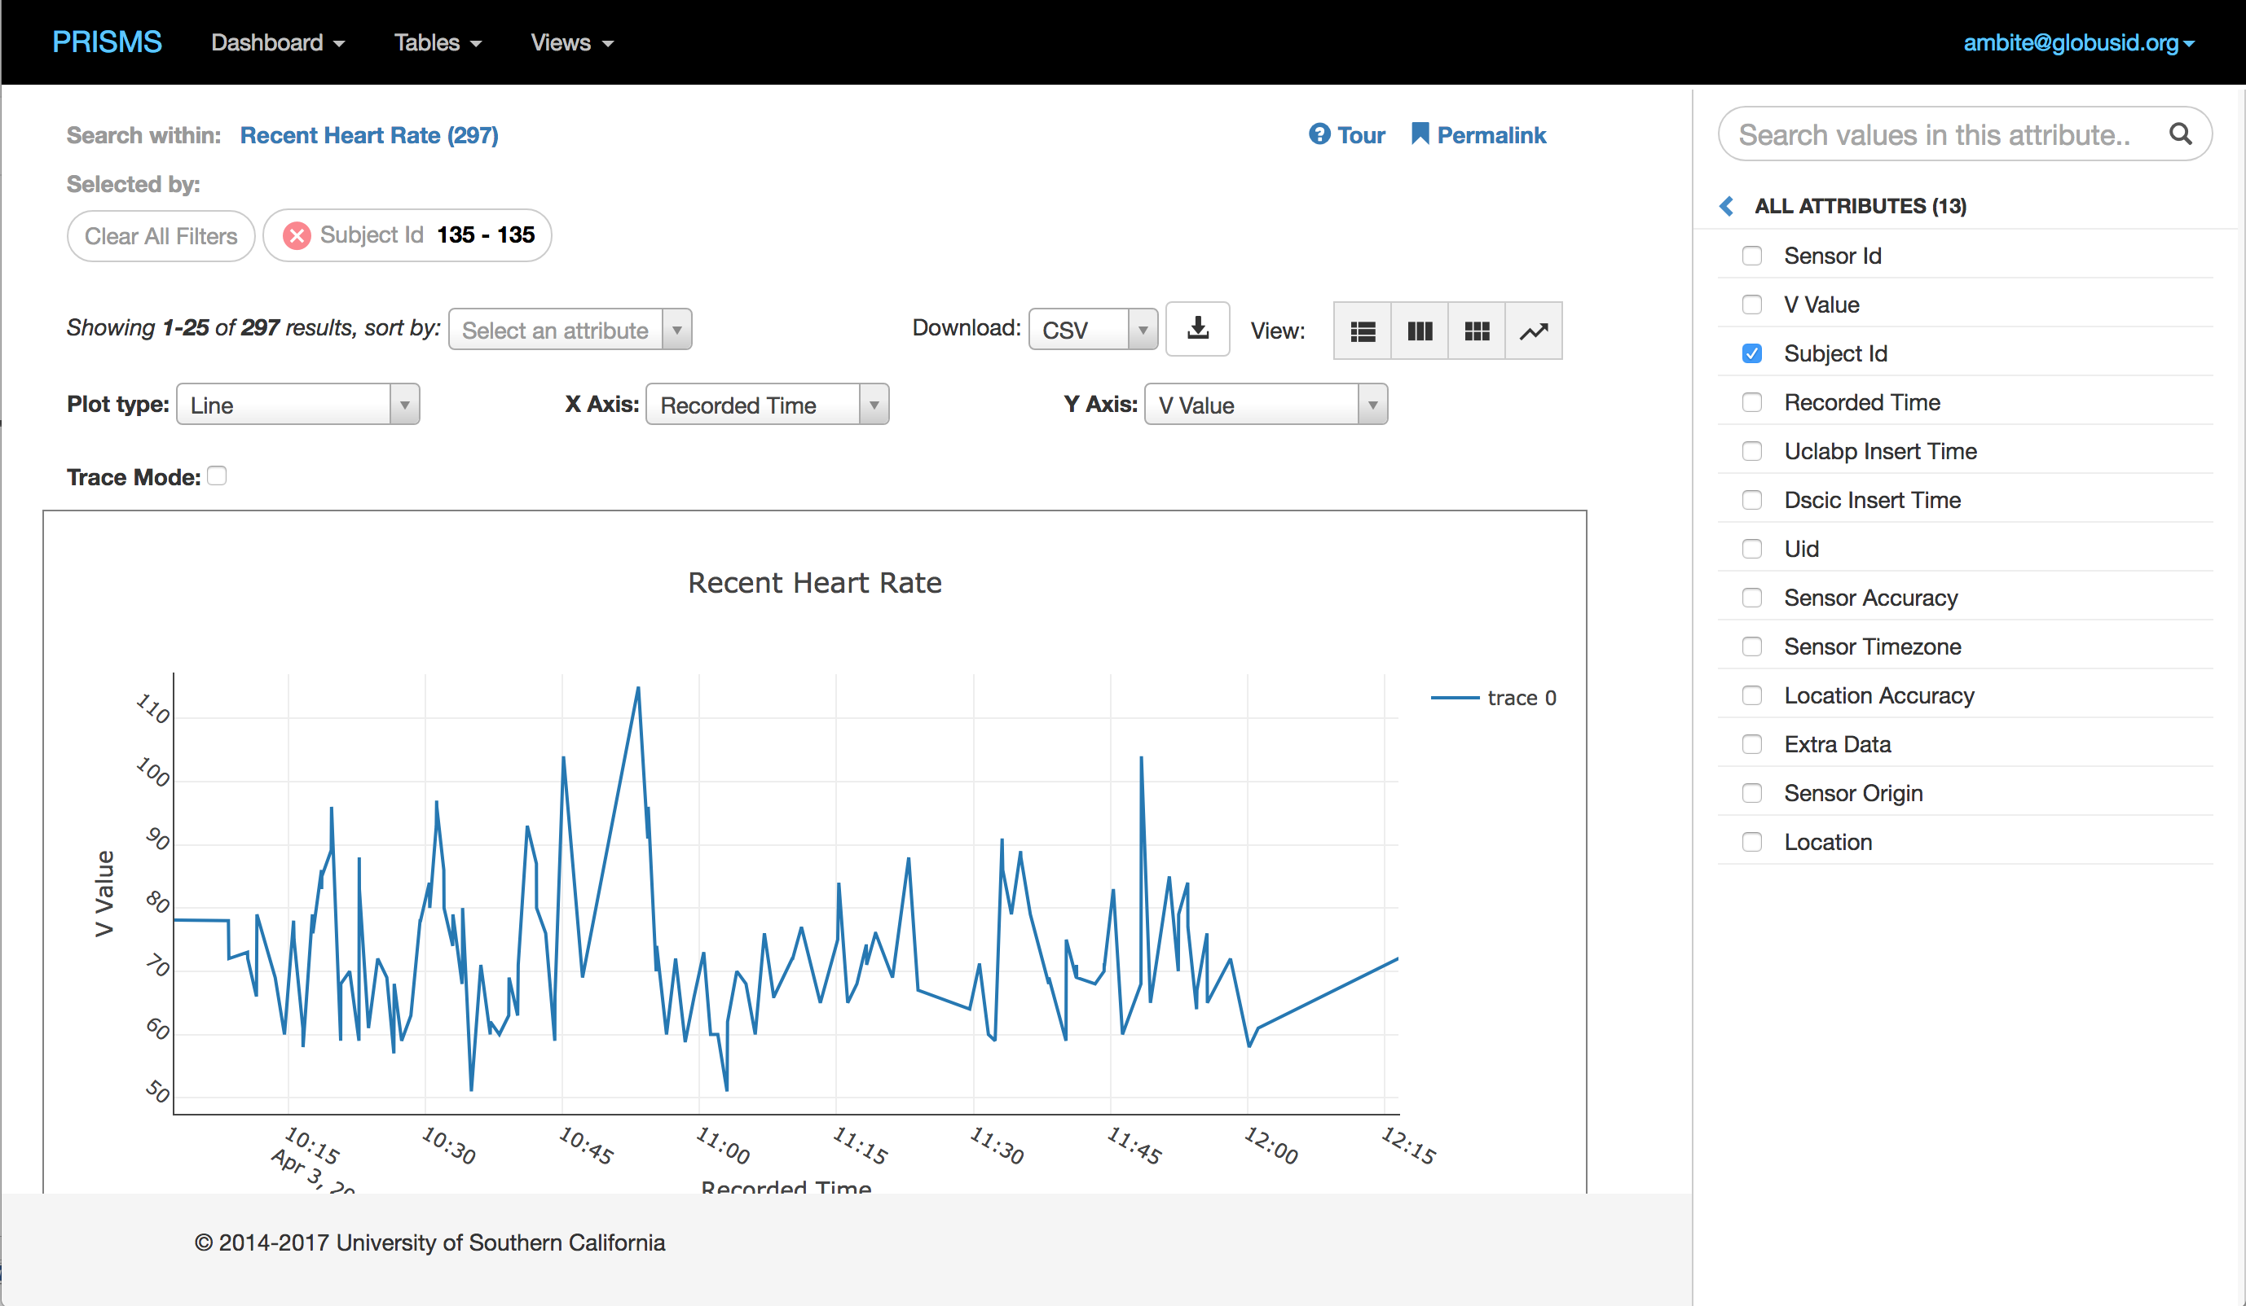
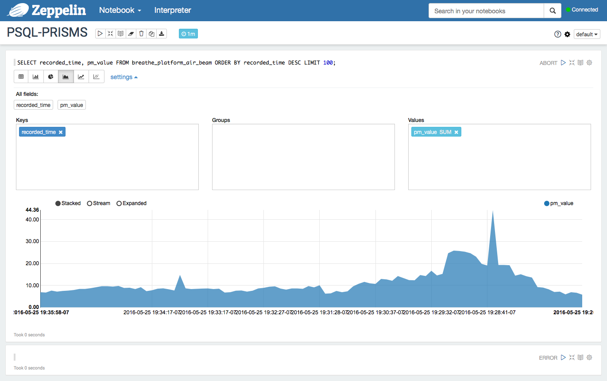










PRISMS-DSCIC Anaytics Architecture
Query &
Visualization
Analytics
General
Data Processing
Integration
Storage
Streaming
…
Data Sources/
Sensors

Slide 53
Schema Mapping/Source Modeling
 | Topics | Readings | Homeworks | Instructor
Mar 20 | Schema Mapping | AnHai Doan, Alon Y. Halevy, and Zachary G. Ives. Principles of Data Integration, chapter 5. Morgan Kaufmann, 2012. Reconciling schemas of disparate data sources: a machine-learning approach, 2001. |  | Prof. Ambite
Mar 25 | Semi-Automatic Source Modeling (Karma) | Craig Knoblock, Pedro Szekely, Jose Luis Ambite, Aman Goel, Shubham Gupta, Kristina Lerman, Parag Mallick, Maria Muslea and Mohsen Taheriyan. Semi-Automatically Mapping Structured Sources into the Semantic Web. ESWC 2012. Optional: Mohsen Taheriyan, Craig A. Knoblock, Pedro Szekely, Jose ́ Luis Ambite. Learning the Semantics of Structured Data Sources. Journal of Web Semantics Special Issue on Knowledge Graphs, 2015. |  | Prof. Ambite
Mar 27 | Automatic Source Modeling | Mark James Carman and Craig A. Knoblock. Learning semantic descriptions of web information sources. IJCAI 2007. Jose ́ Luis Ambite, Sirish Darbha, Aman Goel, Craig A. Knoblock, Kristina Lerman, Rahul Parundekar, and Thomas Russ. Automatically constructing semantic web services from online sources. ISWC 2009. |  | Prof. Ambite

Slide 54
Schema Mapping
Given two different sources with different schemas, how do we automatically align the information
Research Topics
Automatic schema alignment based on structure and naming
Automatic alignment based on the source contents
University of Southern California
Ambite, Knoblock and Szekely

Slide 55
Schema Mapping
Mediated schema
price agent-name agent-phone office-phone description
If “office” occurs in name
=> office-phone
listed-price contact-name contact-phone office comments
Schema of realestate.com
realestate.com
listed-price contact-name contact-phone office comments
$250K James Smith (305) 729 0831 (305) 616 1822 Fantastic house
$320K Mike Doan (617) 253 1429 (617) 112 2315 Great location
If “fantastic” & “great” occur frequently in data instances
=> description
homes.com
sold-at contact-agent extra-info
$350K (206) 634 9435 Beautiful yard
$230K (617) 335 4243 Close to Seattle
Anhai Doan
Notes:
Here’s an example to illustrate our approach. Consider a mediated schema with elements price, agent-name, agent-phone, and so on.
To apply LSD, first the user selects a few sources to be the training sources. In this case, the user selects a single source, realestate.com [POINT]. Next, the user manually specifies the 1-1 mappings between the schema of this source and the mediated schema. These mappings are the five green arrows right here [POINT], which say that listed-price matches price, contact-name matches agent-name, and so on.
Once the user has shown LSD these 1-1 mappings, there are many different types of information that LSD could learn from, in order to construct hypotheses on how to match schema elements. For example, LSD could learn from the names of schema elements. Knowing that office matches office-phone, it may construct the hypothesis [POINT] that if the word ”office" occurs in the name of a schema element, then that element is likely to be office-phone.
LSD could also learn from the data values. Because comments matches description, LSD knows that these data values here [POINT] are house descriptions. It could then examine them to learn that house descriptions frequently contain words such as fantastic, great, and beautiful. Hence, it may construct the hypothesis [POINT] that if these words appear frequently in the data values of an element, then that element is likely to be house descriptions.
LSD could also learn from the characteristics of value distributions. For example, it can look at the average value of this column [POINT], and learn that if the average value is in the thousands, then the element is more likely to be price than the number of bathrooms. And so on.
Now, consider the source homes.com, with these schema elements [POINT] and these data values [POINT]. LSD can apply the learned hypotheses to the schema and the data values, in order to predict semantic mappings. For example, because the words "beautiful" and "great" appear frequently in these data values, LSD can predict that "extra-info" matches "description”.
... and the solution to this is MULTI-STRATEGY LEARNING [PAUSE]

Slide 56
Source Modeling
Semantic typing
Source discovery
Interactive source modeling
Automatic source modeling
University of Southern California
Ambite, Knoblock and Szekely

Slide 57
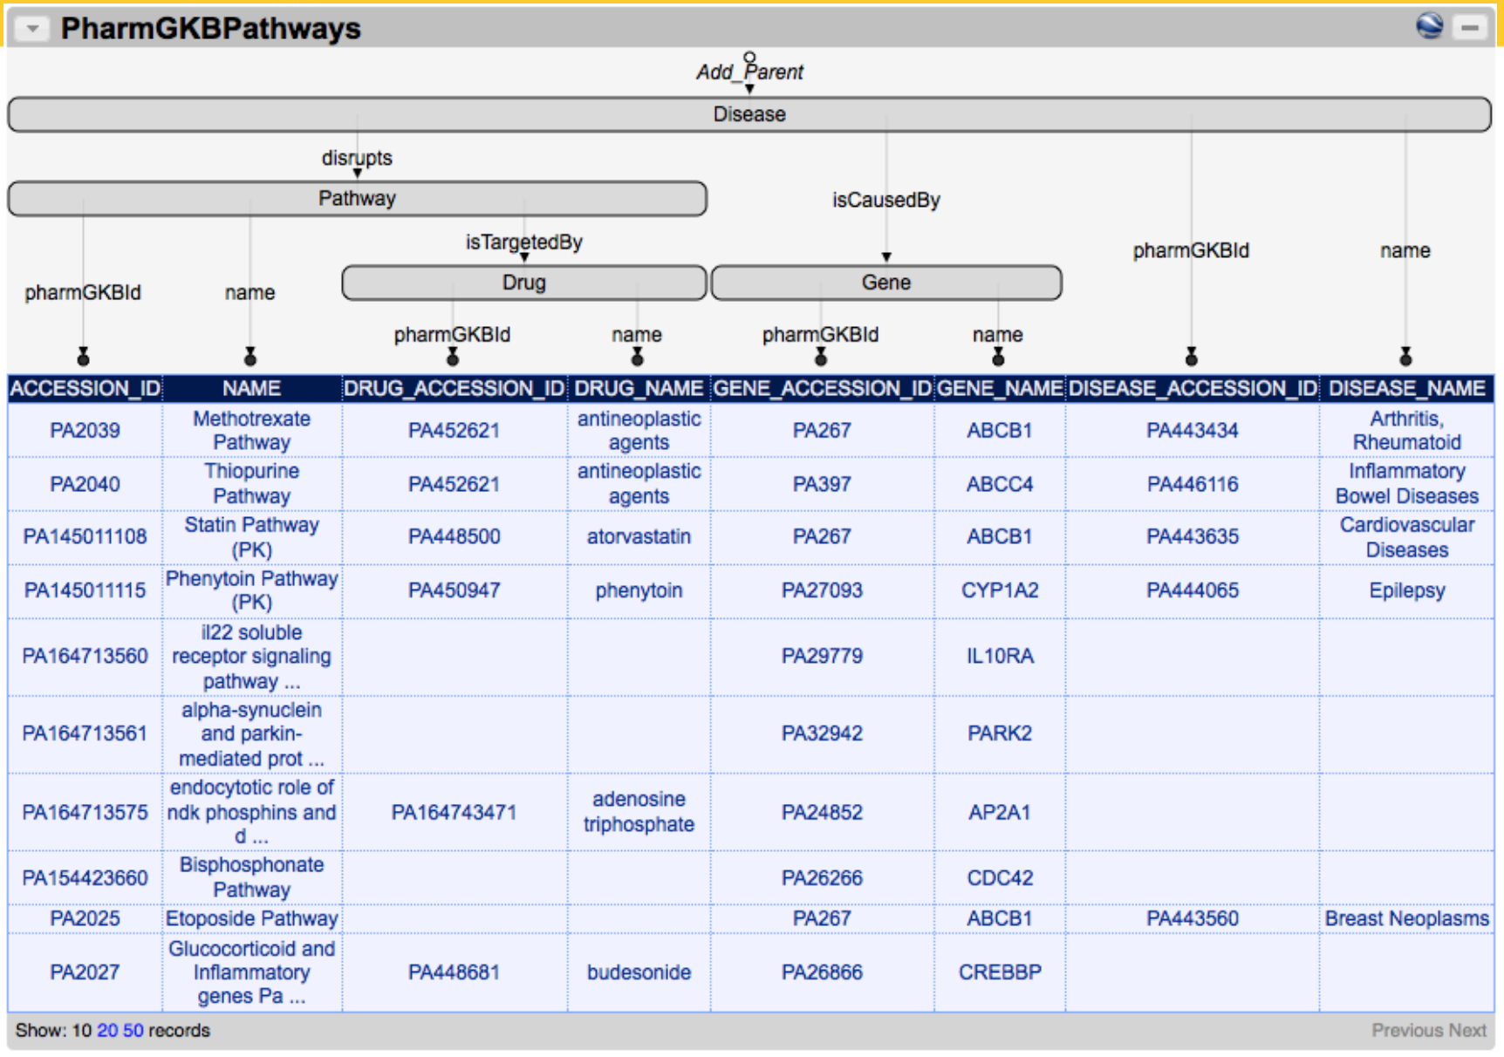
Semi-Automatic Source Modeling: Karma
http://www.isi.edu/integration/karma/

Slide 58
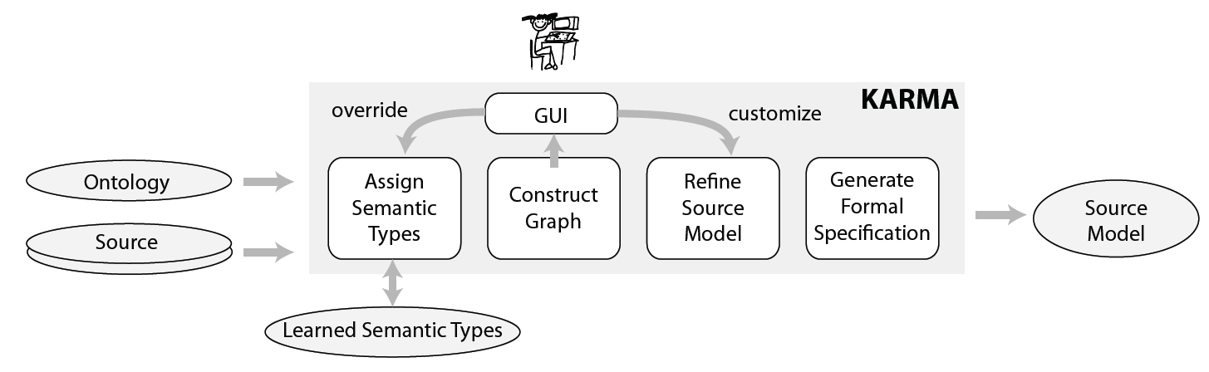
Semi-Automatic Source Modeling
Relational database to RDF mapping
Anything to RDF mapping
University of Southern California
Ambite, Knoblock and Szekely

Slide 59
Automatic Source Modeling
How to learn semantic descriptions of sources and services
Data
Integration
Orbitz Flight
Search
lowestFare(“LAX”,“MXP”)
Query
Reformulated Query
Reformulated Query
United
Airlines
SELECT MIN(price)
FROM flight
WHERE depart=“LAX”
AND arrive=“MXP”
calcPrice(“LAX”,“MXP”,”economy”)
Qantas
Specials
Reformulated Query
Source Definitions:
Orbitz Flight Search
United Airlines
- Qantas Specials
New Service:
Alitalia
Generate Model of Service
University of Southern California
Ambite, Knoblock and Szekely

Slide 60
Automatic Source Modeling
discovery
unisys
Invocation &
extraction
anotherWS
Background knowledge
sample
input
values
“90254”
Seed URL
unisys
http://wunderground.com
unisys(Zip,Temp,…)
:-weather(Zip,…,Temp,Hi,Lo)
definition of known sources
sample values
patterns
domain
types
source
modeling
semantic
typing
unisys(Zip,Temp,Humidity,…)

Slide 61
Semantic Web
 | Topics | Readings | Homeworks | Instructor
Apr 1 | RDF | Frank Manola and Eric Miller. RDF primer. Technical report, W3C, February 2004. Tim Berners-Lee. Why rdf model is different from the xml model. Technical report, W3C, 1998. |  | Prof. Ambite
Apr 3 | RDF Schema / Inference | RDF Schema 1.1: W3C Recommendation 25 February 2014. https://www.w3.org/TR/rdf-schema/ |  | Prof. Ambite
Apr 8 | SPARQL Query Language | SPARQL 1.1 Query Language: W3C Recommendation 21 March 2013. |  | Prof. Ambite
Apr 10 | OWL2 and Ontology-based Data Integration | Krtzsch Markus, Simancik Frantisek, and Horrocks Ian. A description logic primer. 2012. Diego Calvanese, Giuseppe De Giacomo, Domenico Lembo, Maurizio Lenzerini, and Riccardo Rosati. DL-lite: tractable description logics for ontologies. AAAI 2005. Hector Prez-Urbina, Ian Horrocks, and Boris Motik. Efficient query answering for OWL 2. ISWC 2009. | HW6: RDF/S SPARQL OWL (due Apr 19) | Prof. Ambite

Slide 62
Can You Google the Answer to These Questions?
Which US cities have more than 500,000 people?
Which congress members voted “No” on pro-environmental legislation in the past four years, with high-pollution industry in their congressional districts?
Find all stores that sell a Canon EOS 7D for less than $1,400
How many Twitter followers does Obama have in each state?
Trump
And how many are Russian bots?
University of Southern California
Ambite, Knoblock and Szekely

Slide 63
Semantic Web
A machine-readable semantic layer on the web
Research Topics
Organizing knowledge
Formal languages: XML, RDF, OWL, FOL
Reasoning and querying over semantic web data
Provenance, Trust
Linked Data
University of Southern California
Ambite, Knoblock and Szekely

Slide 64
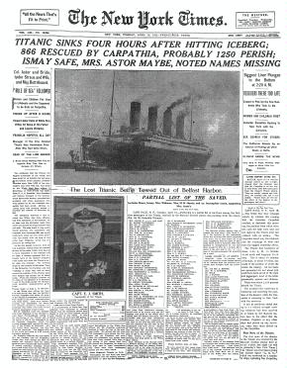
New York Times Index
Started in 1851, cross ref’d every NYT article, published since 1913
10k tags on all kinds of topics
3500 in very frequent use
Open License, usable as reference ontology for anybody
BTW: strong internal use of semantic technologies for … targeting advertising
slide from Frank van Harmelen

Slide 65
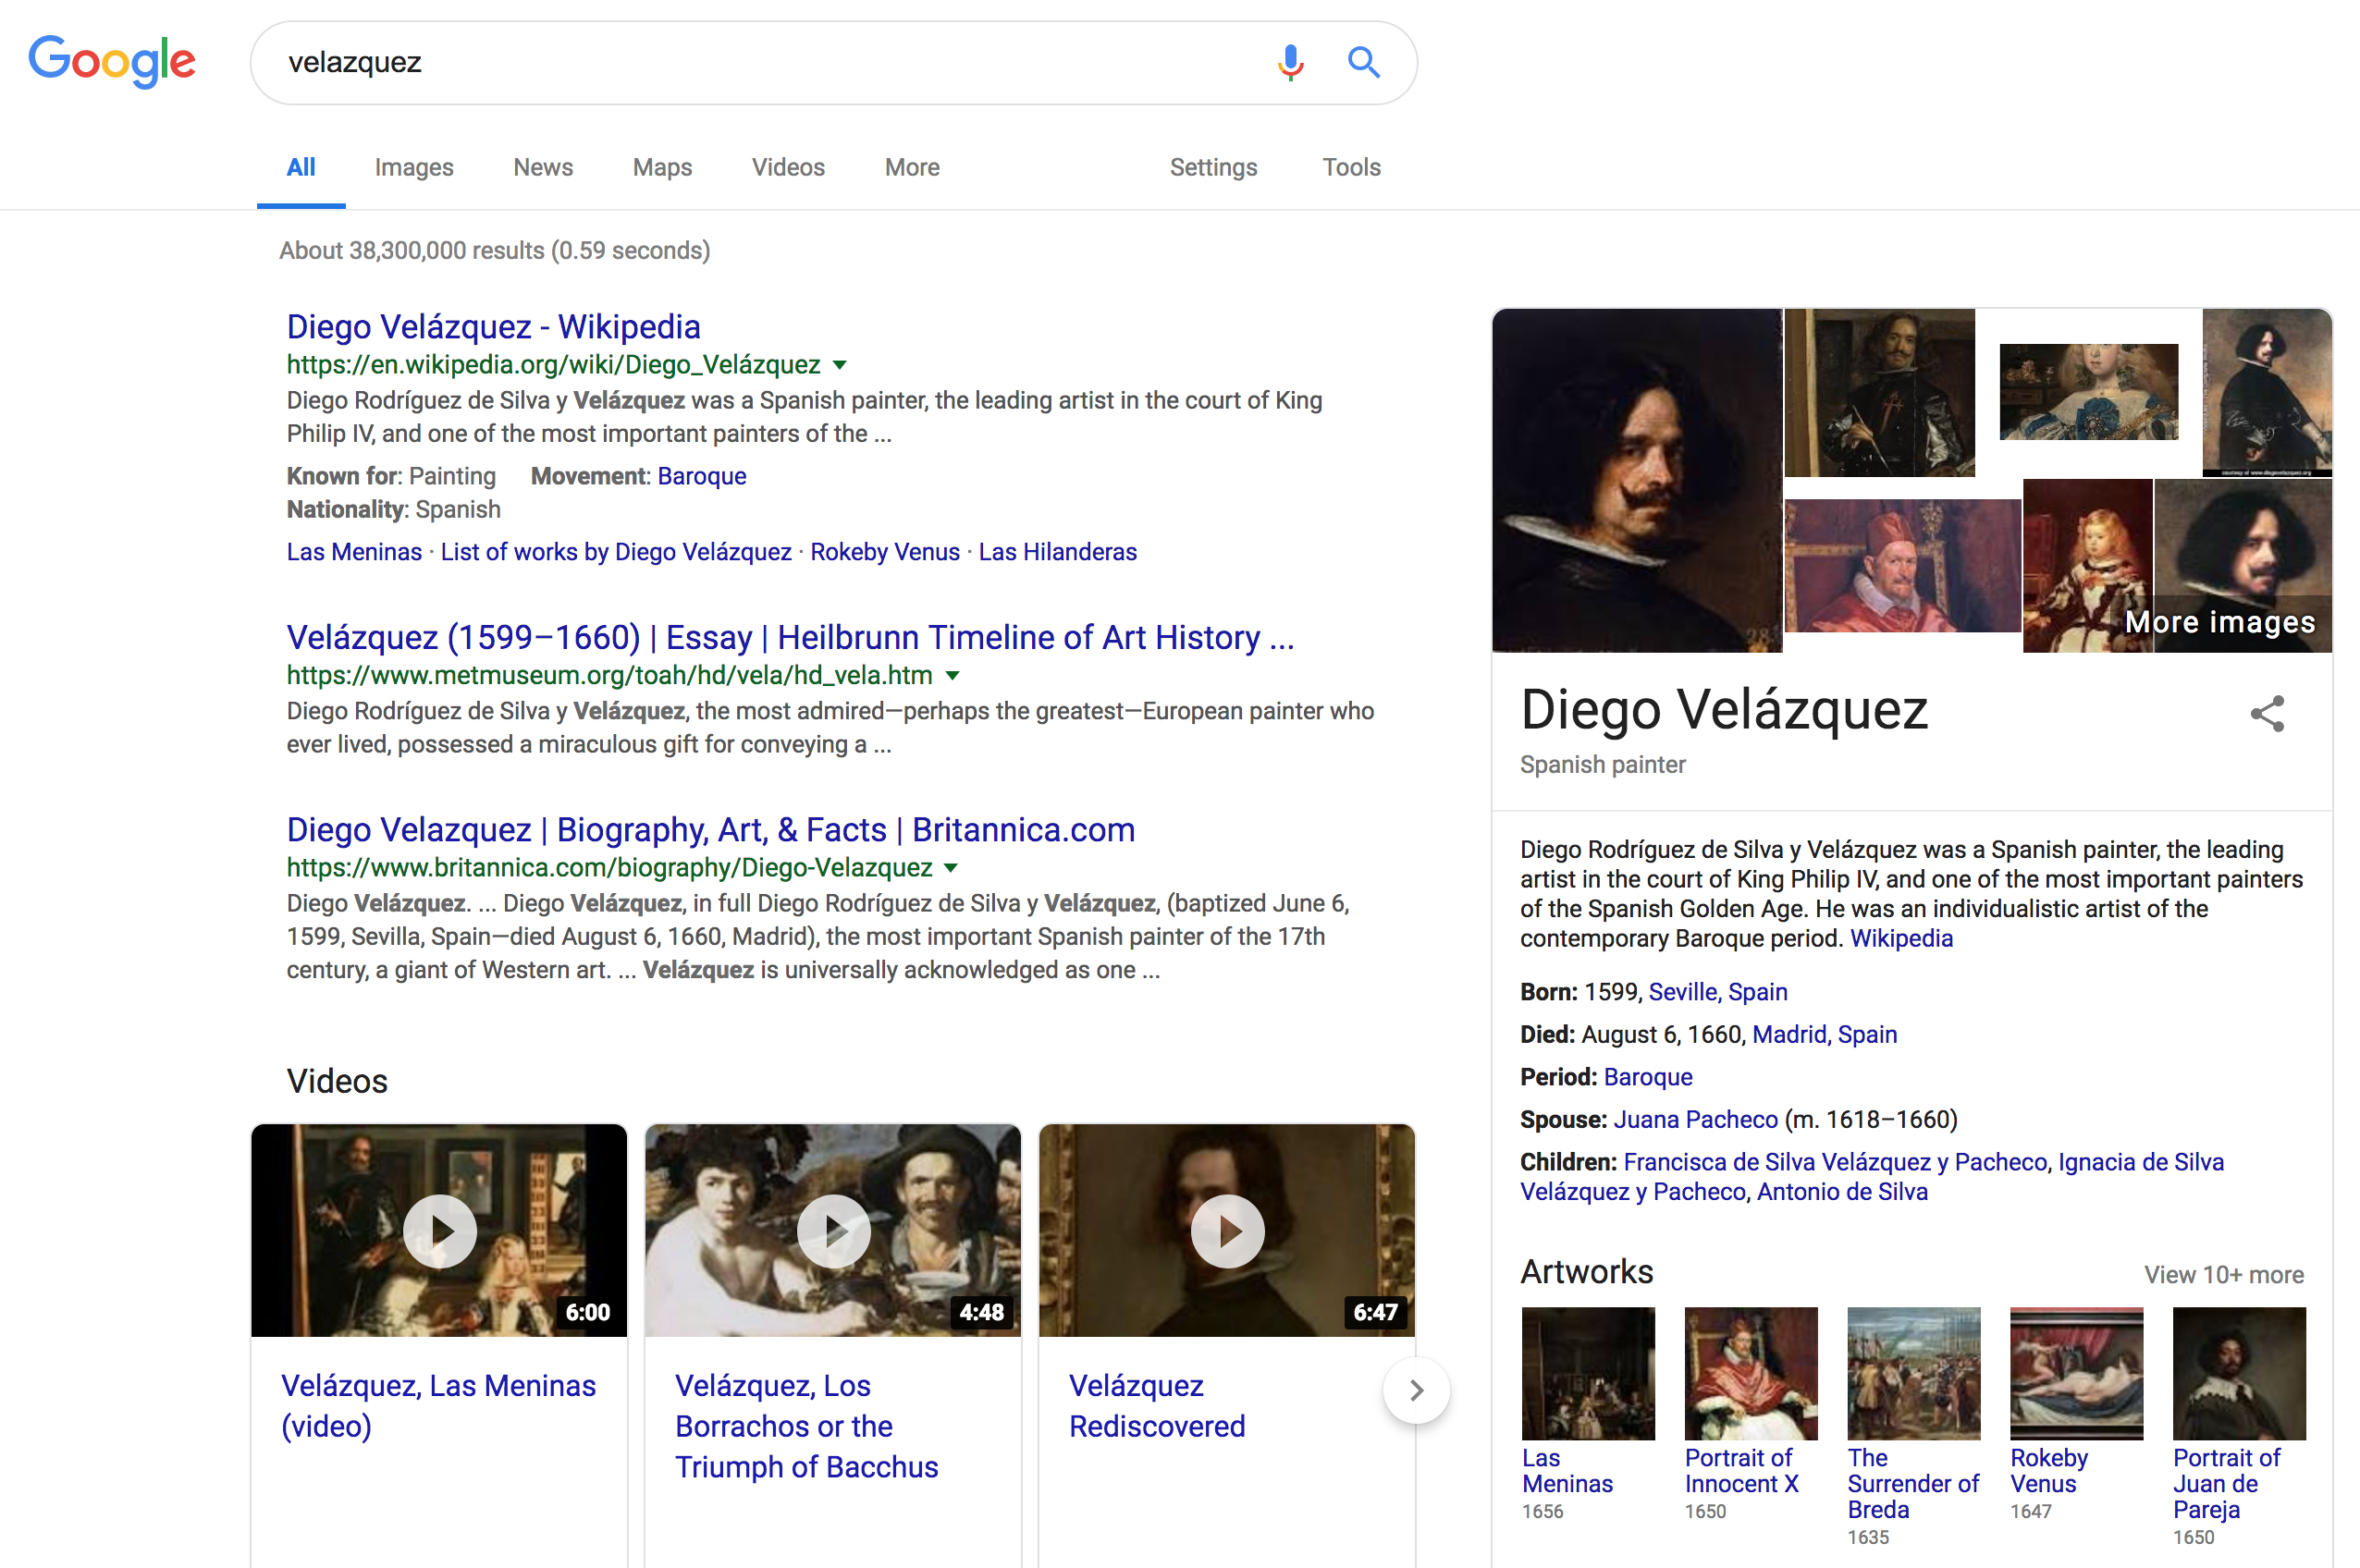
Knowledge Graph

Slide 66
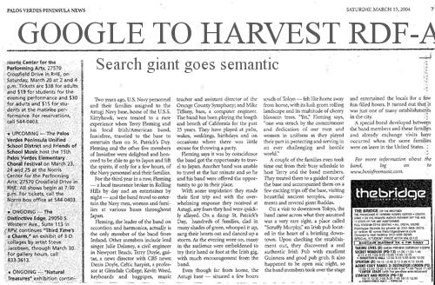
http://googlewebmastercentral.blogspot.com/2009/05/introducing-rich-snippets.html
slide from Frank van Harmelen
Notes:
Slide 3

Slide 67
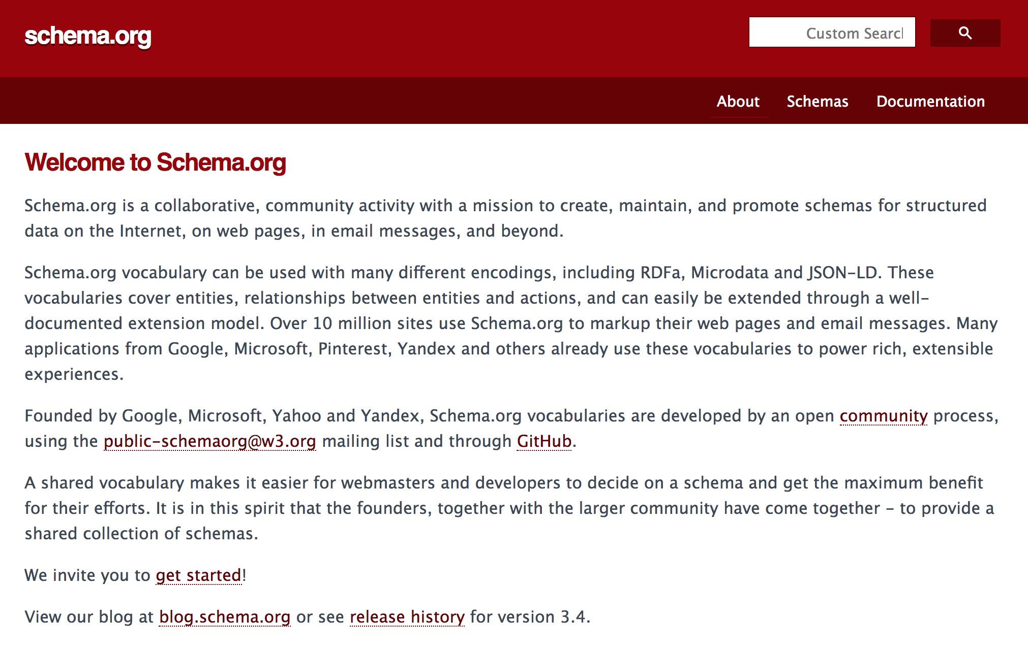

Slide 68

Linked Data
a giant Web-scale graph of data about everything
Wikipedia: “… recommended best practice for exposing, sharing, and connecting pieces of data, information, and knowledge on the Semantic Web using URIs and RDF.”
31+ billion assertions
University of Southern California
Ambite, Knoblock and Szekely

Slide 69
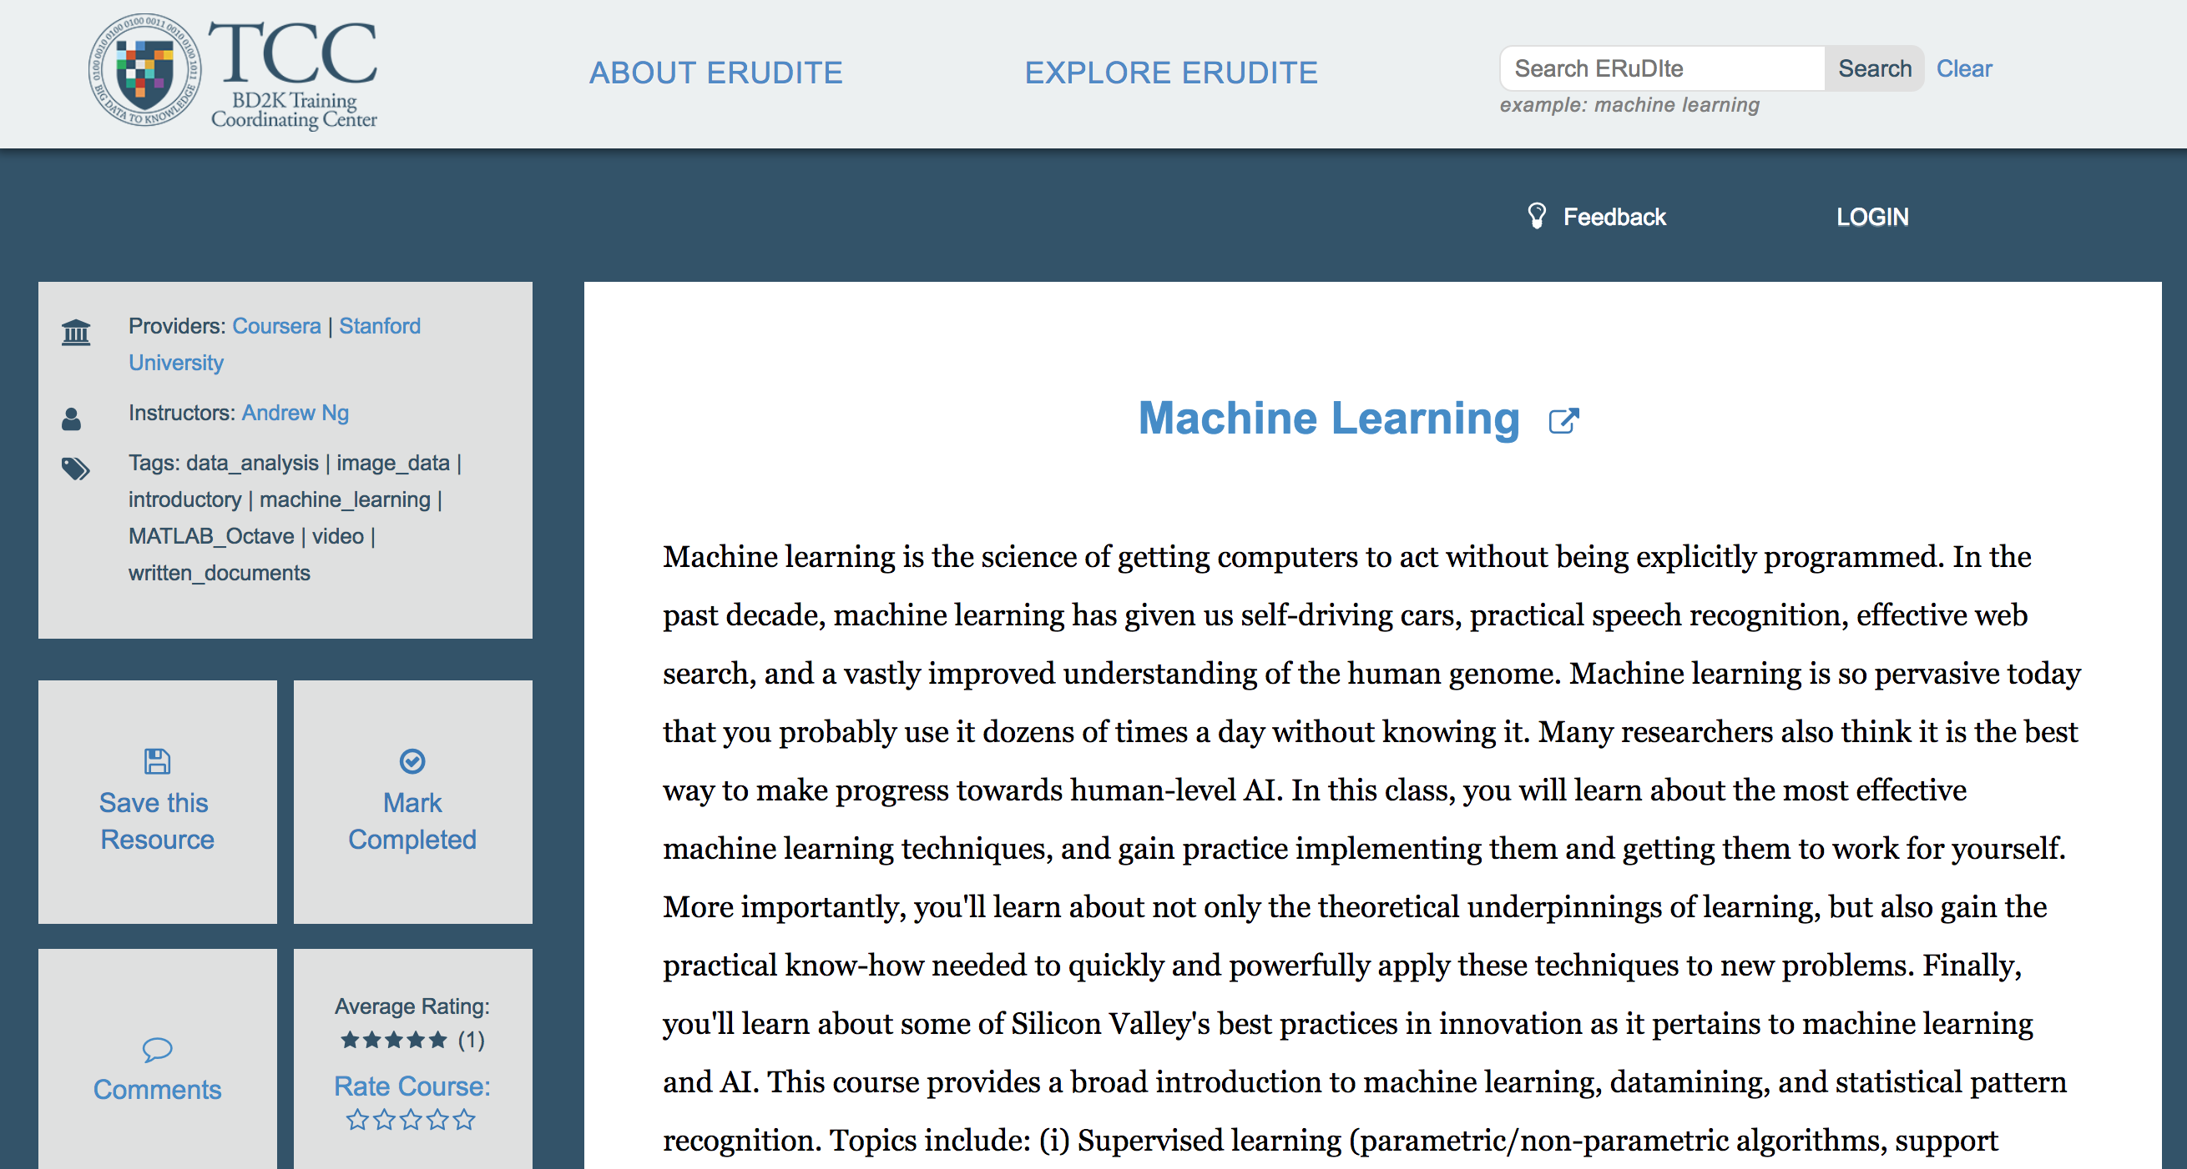
BigDataU.org (HTML)

Slide 70
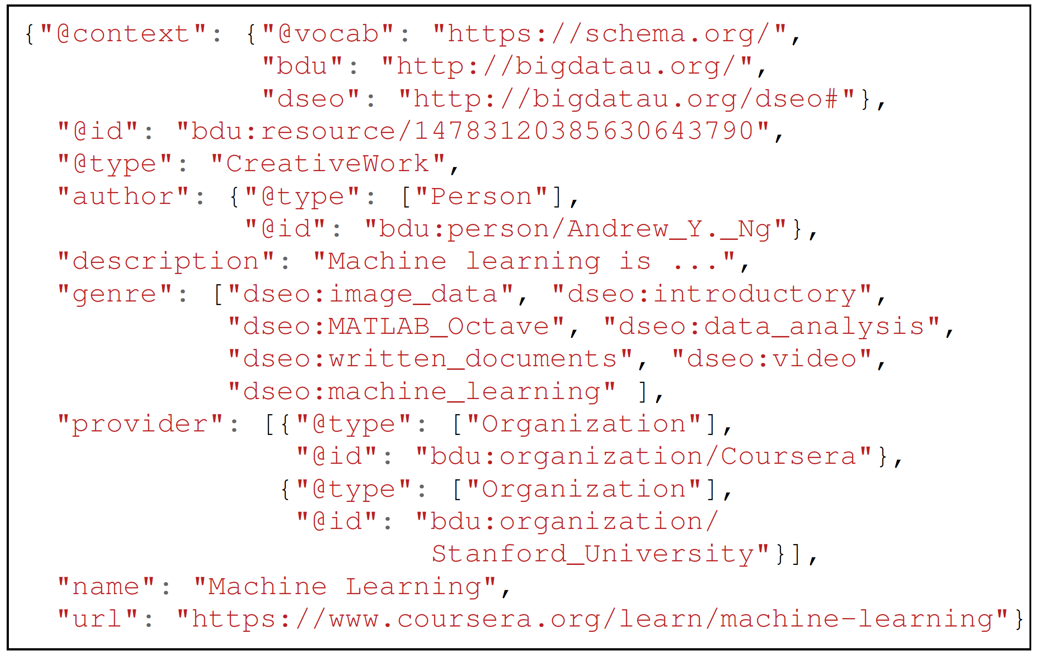
BigDataU.org: Embedded schema.org

Slide 71
Linked Data
Why Linked Data
The Linked Data principles
Web of data
How to Publish Linked Data on the Web
Tools
Applications
University of Southern California
Ambite, Knoblock and Szekely

Slide 72
Semantic Web Layer Cake
University of Southern California
Ambite, Knoblock and Szekely

Slide 73

University of Southern California
[From https://en.wikipedia.org/wiki/RDF_Schema]
Ambite

Slide 74


SPARQL: Querying RDF graphs

Slide 75

Semantic Web: Description Logics, Ontology Web Language (OWL2)
formal underpinning of the semantic web
HappyParent = Person ∧ ∀hasChild.(Doctor∨Rich))
University of Southern California
Ambite, Knoblock and Szekely

Slide 76
Ontology-based data access and integration
Use ontology language as domain model
OWL2 profiles
Answering queries under description logic constraints
Unions of conjunctive queries
Datalog

Slide 77





Ontology-based data access and integration: Example Rewriting
Ontology:
Clauses:
Query:
Rewriting:
Main idea: compile the ontology inferences into the query

Slide 78


Knowledge Graphs
Tensor factorization
for link prediction

Slide 79




Network Extraction

Slide 80
Course Mechanics

Slide 81
Course Materials and Web Pages
Dropbox folder
http://bit.ly/2VzHT5U
All readings, slides, homeworks, etc will be posted on the shared Dropbox folder
Google discussion board
All questions should be posted
Expect response from TA in 24 hours, otherwise let Profs know
If you know the answer to a posted question, please try to provide helpful suggestions
But please don’t post answers to homeworks!
Blackboard – blackboard.usc.edu
Submit homeworks on Blackboard
University of Southern California
Ambite, Knoblock and Szekely

Slide 82
Prerequisites & Recommended
Prerequisites
CS561 -- Introduction to AI
Recommended
CS585 – Database Systems
Some programming experience
University of Southern California
Ambite, Knoblock and Szekely

Slide 83
Grading
Homework: 20%
Must be turned in on time, but
25% penalty if late one week
Quizzes: 20%
One per week, at the beginning of the class
Questions based on the lectures, readings, and homeworks from previous week
No make ups
We will drop the lowest grade
Final Exam: 20%
Project: 40%
University of Southern California
Ambite, Knoblock and Szekely

Slide 84

More on Grading
This is a hard class, but you will learn a lot!
Principles and theory
Technical readings and lectures (quizzes, final exam)
Putting principles into practice
Homeworks and project!
Grade distribution
University of Southern California
Ambite, Knoblock and Szekely

Slide 85
Readings
Posted on dropbox each week
You can read it online or print them
Read all required readings before class
You will get more out of the lectures
Optional readings go in more depth
Read them to learn more
University of Southern California
Ambite, Knoblock and Szekely

Slide 86
Slides
Available online before the lecture
Not intended as a replacement for the lecture
Final version of the slides available after class
University of Southern California
Ambite, Knoblock and Szekely

Slide 87
Working Together
Each person must do their own homework
We will check for overlap in homeworks
If we find any plagiarism, all parties lose credit so
Don’t share your answers
Don’t leave printouts in the trash with your answers
Don’t give out your password
Don’t copy others (they may have the wrong answer anyway!)
You can ask the professors or TAs for help
University of Southern California
Ambite, Knoblock and Szekely

Slide 88
Cheating
Not tolerated!
All infractions will be reported
Examples:
Turning in someone else’s homework
Doing the homework in collaboration with someone else and then turning in your own copy
Copying from someone else during a quiz or exam
University of Southern California
Ambite, Knoblock and Szekely

Slide 89


We Follow USC Policies
Print it (from Blackboard), read it, sign it and return it to us

Slide 90
Course Projects
This year two options:
Instructors will suggest projects
Implement data integration technique
From state-of-the-art papers
Novel ideas
Contribute to open source implementation
Propose a data integration project that interests you
Convince instructors it’s really cool/useful

Slide 91
Potential Projects
Named entity recognition
Relation extraction
Entity linkage (without reference set)
Entity normalization (using reference set, e.g., Wikipedia)
Blocking for record linkage
Event extraction (Twitter, News, biomedical literature)
Automatic data cleaning
Query Rewriting under constraints, OBDA
Mediation over big data architectures: SPARK
Learning Schema mappings
Semantic Similarity

Slide 92
Project Details
Find/learn about top 5-10 best performing methods for specific task
Develop an open-source python package
Use common data structures/interface for projects to interoperate
Using minimum number of dependencies
Deep Learning methods should use Tensorflow
Evaluate/compare implemented method using appropriate benchmarks
performance and time complexity
Document
Write clear documentation about the package
Make Jupyter Notebook demos on how to use the package
Make video describing demo notebooks and functionalities of the package
Disseminate
Publish package, notebooks on github (& Pipy) with Open Source license
Write survey/demo paper about package/methods. Put it on Arxiv
Ideally, publish on “The Journal of Open Source Software” or scientific conference

Slide 93

Groups of Two
http://pedroszekely.blogspot.com/2013/07/tips-for-working-successfully-in-group.html
University of Southern California
Ambite, Knoblock and Szekely

Slide 94
When the Course is Over
Directed research (MS or Phd Students)
M.S. Thesis
Summer interns (MS or Phd)
Research Assistantships (1-2 Phd Students)
We can also recommend you for positions in other groups
Graders/Course Producers (MS)
Recommendation letters (anyone that gets at least an A-)
Positions at related companies
Companies are often looking for recommendations of students
University of Southern California
Ambite, Knoblock and Szekely

Slide 95
Waiting List
Even if you are in the waiting list, come to the classes and do the quizzes/homeworks
Likely there will be additional openings in the next couple of weeks

Slide 96
Questions?

